Slide 1
Electricity Coupled with the Transport Sector
Electricity Mismatch Analysis

Slide 2
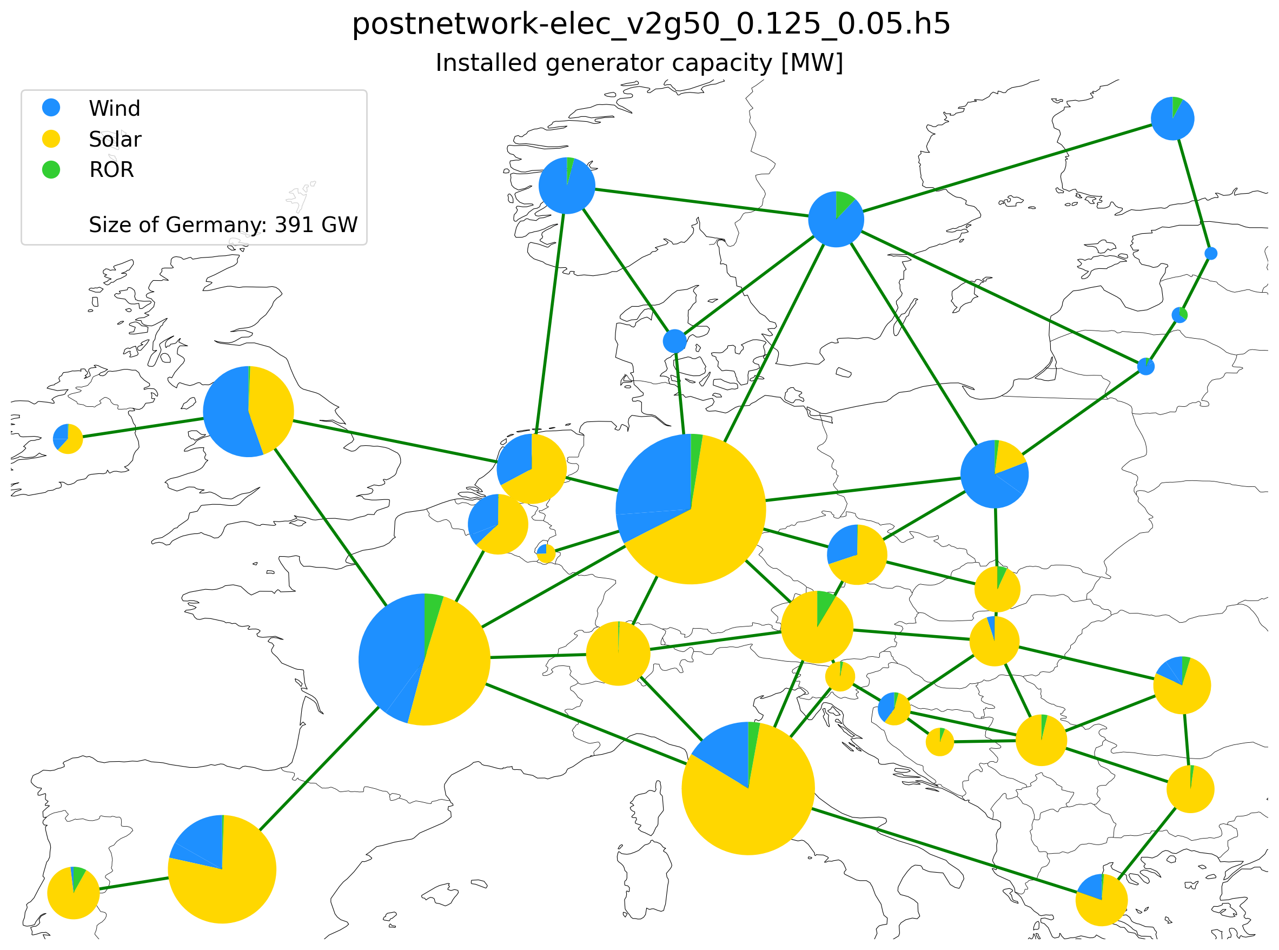
Installed capacity

Slide 3
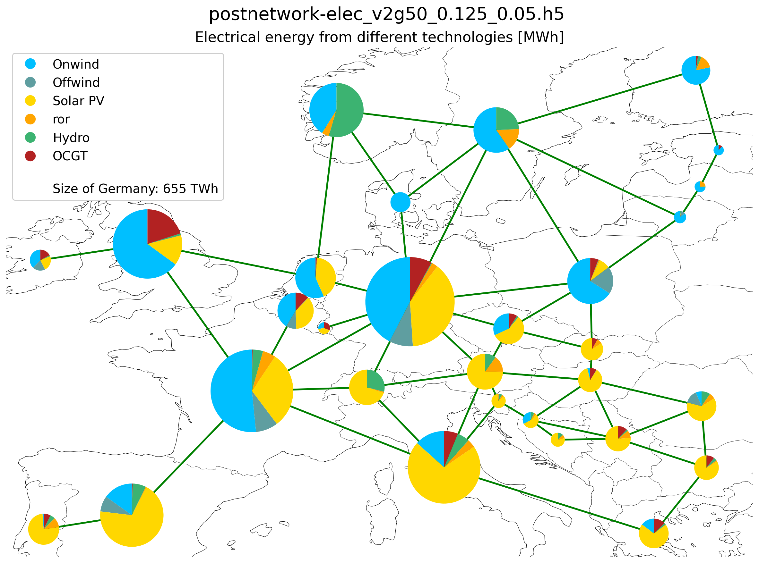
Electricity Supplied by Different Technologies

Slide 4
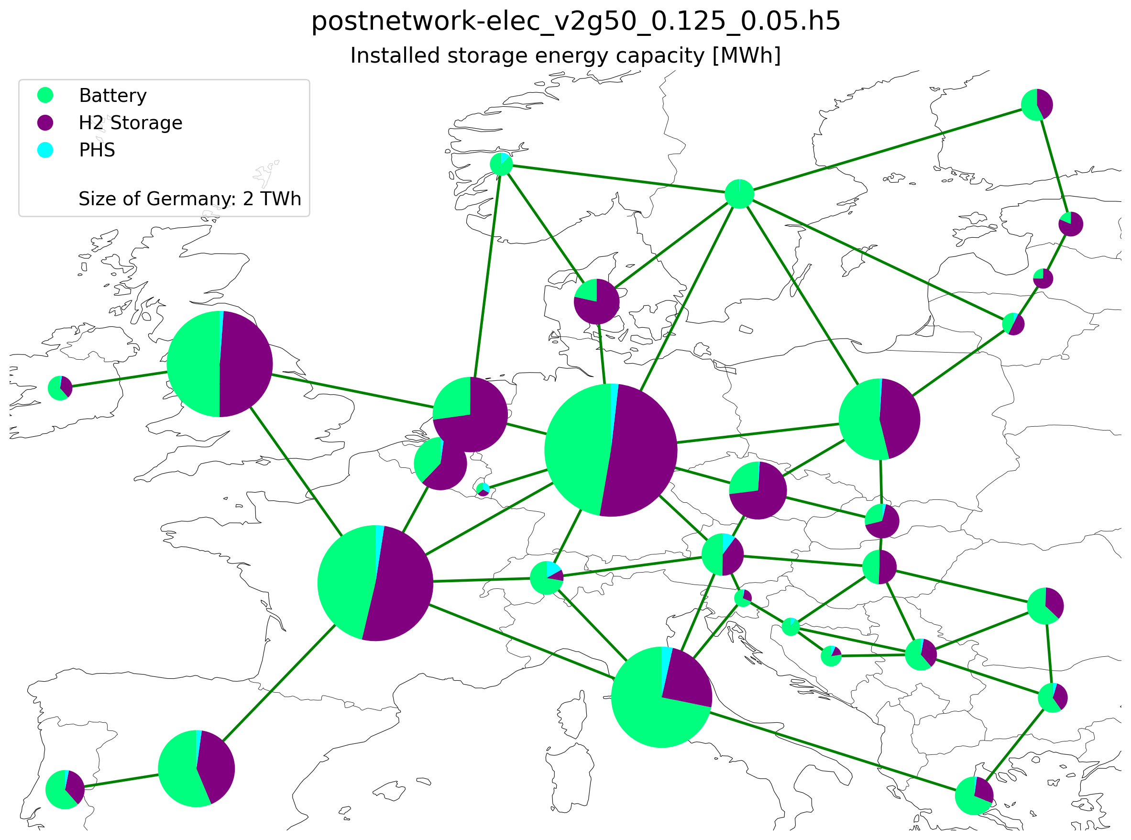
Installed storage (energy capacity)

Slide 5
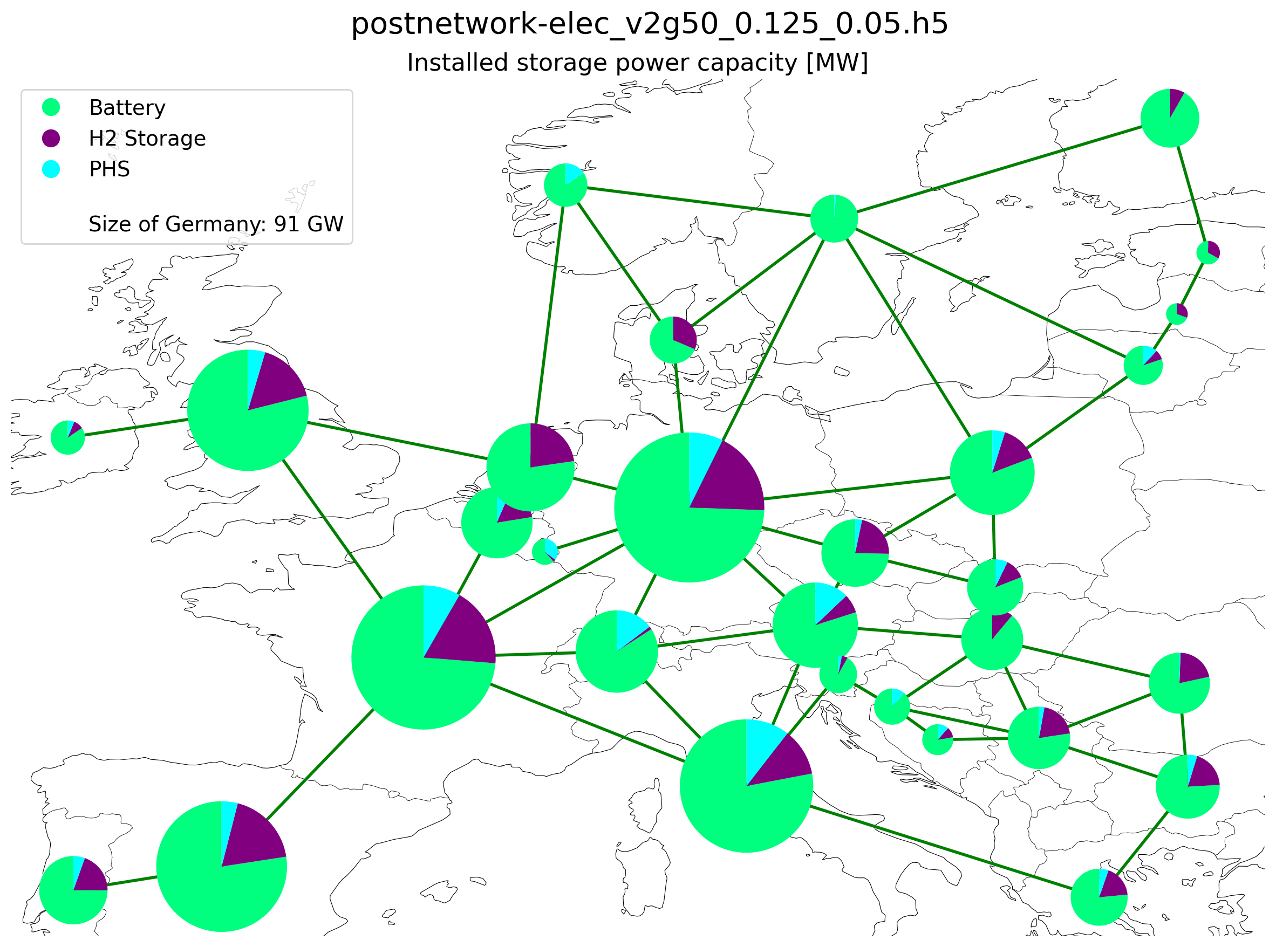
Installed storage (power capacity)

Slide 6
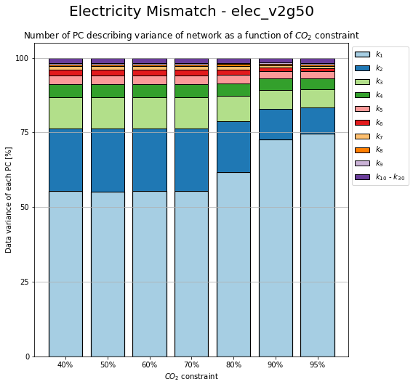
Change in PC due to CO2 Constrain

Slide 7
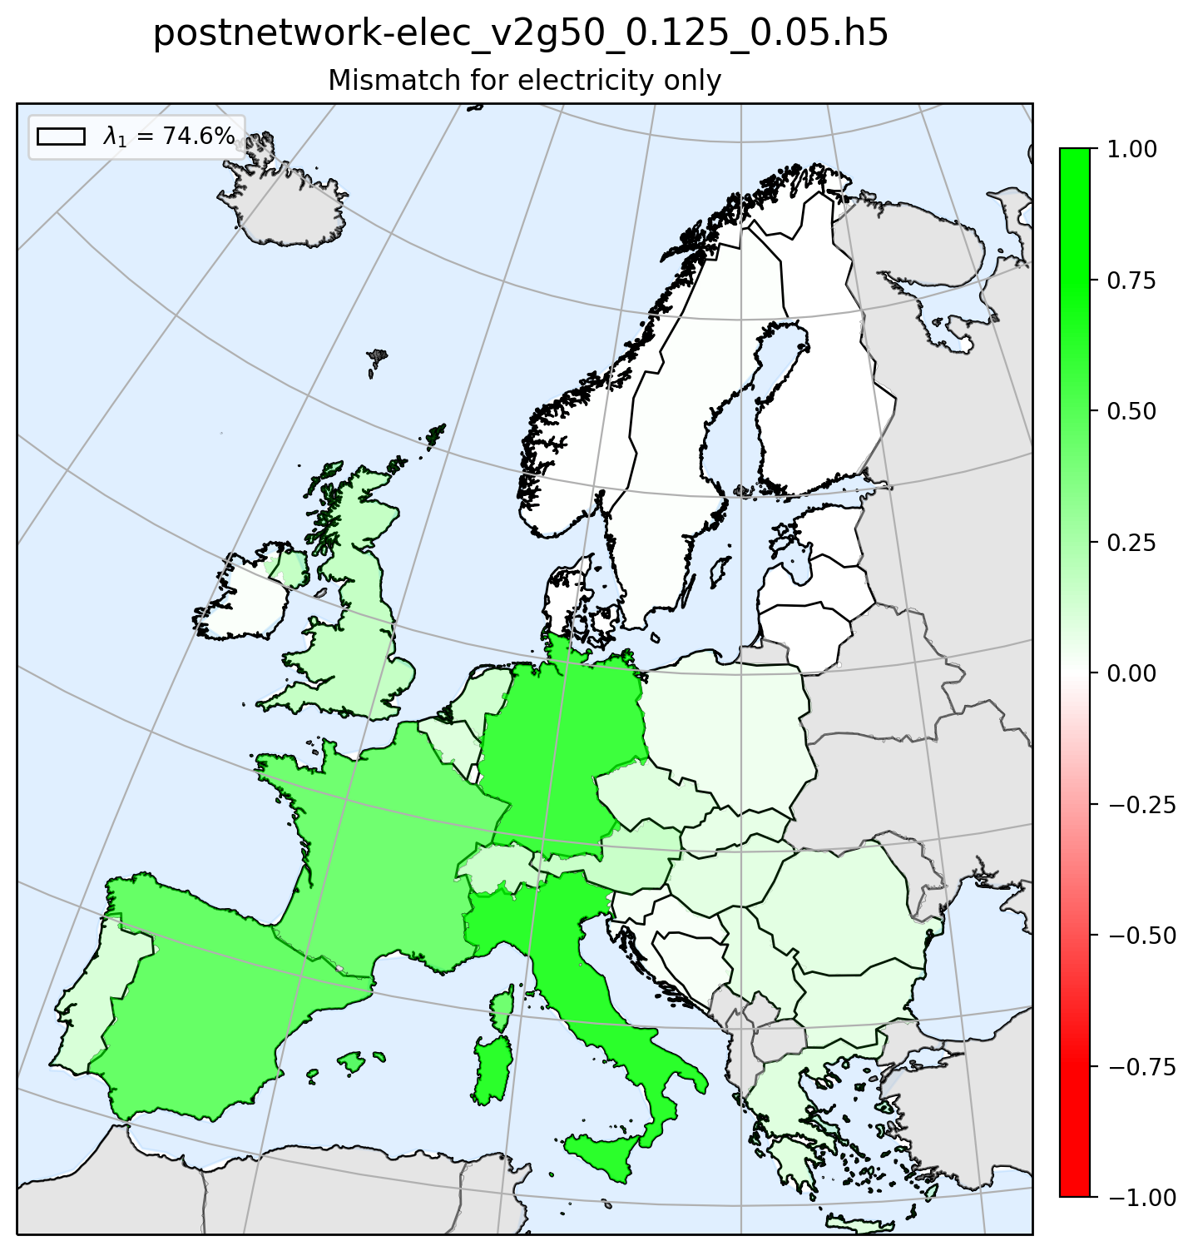
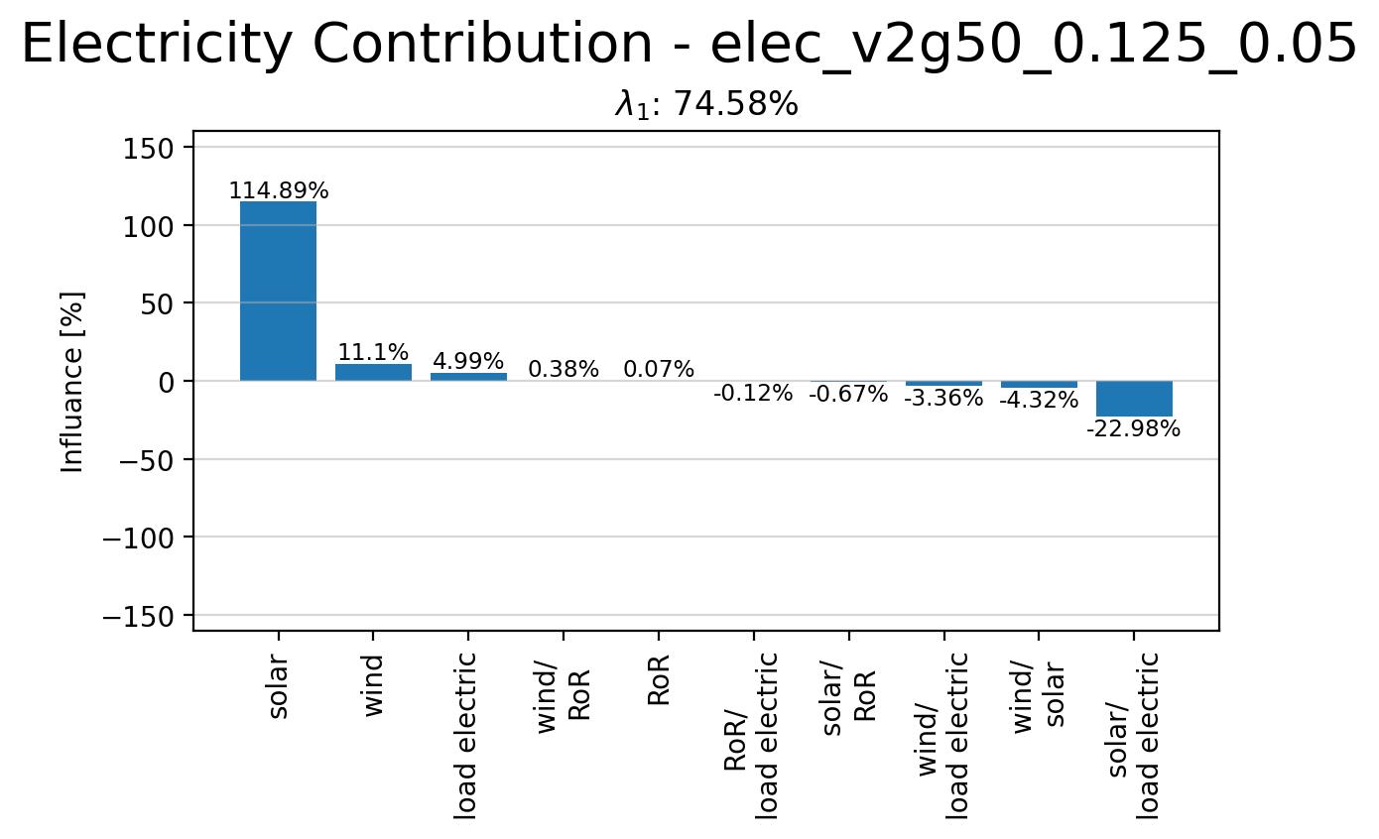
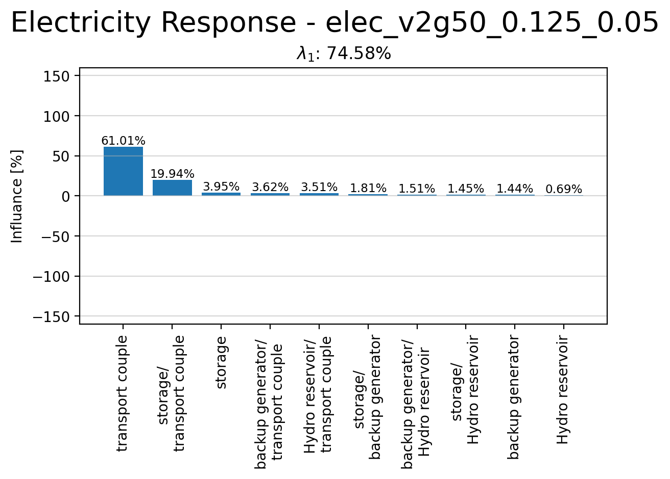
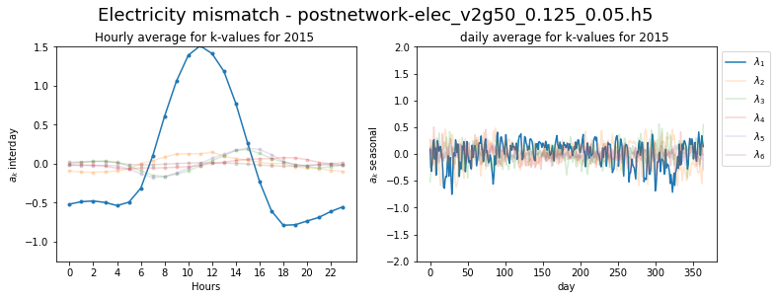
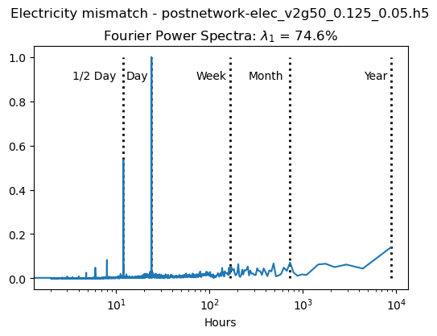
Principle Component 1

Slide 8
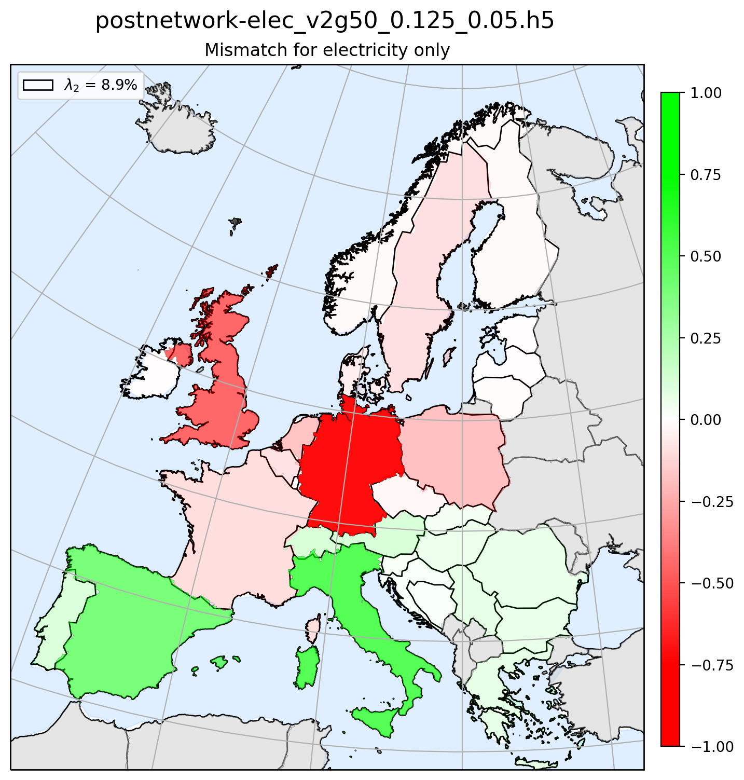
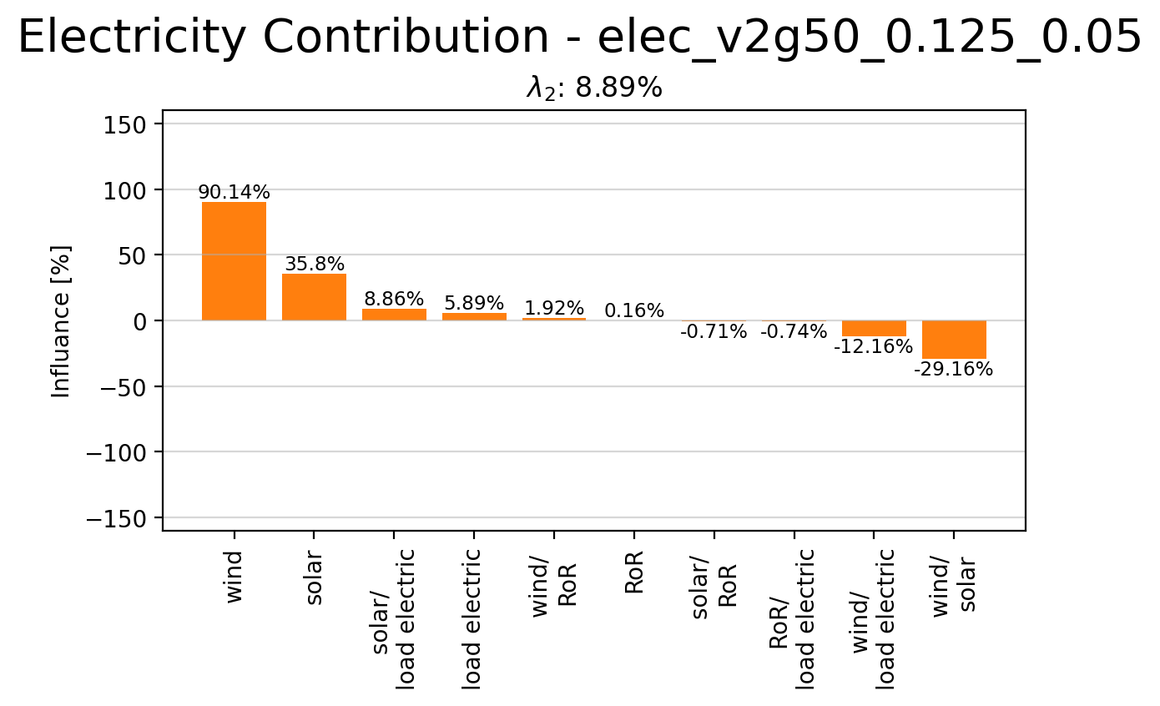
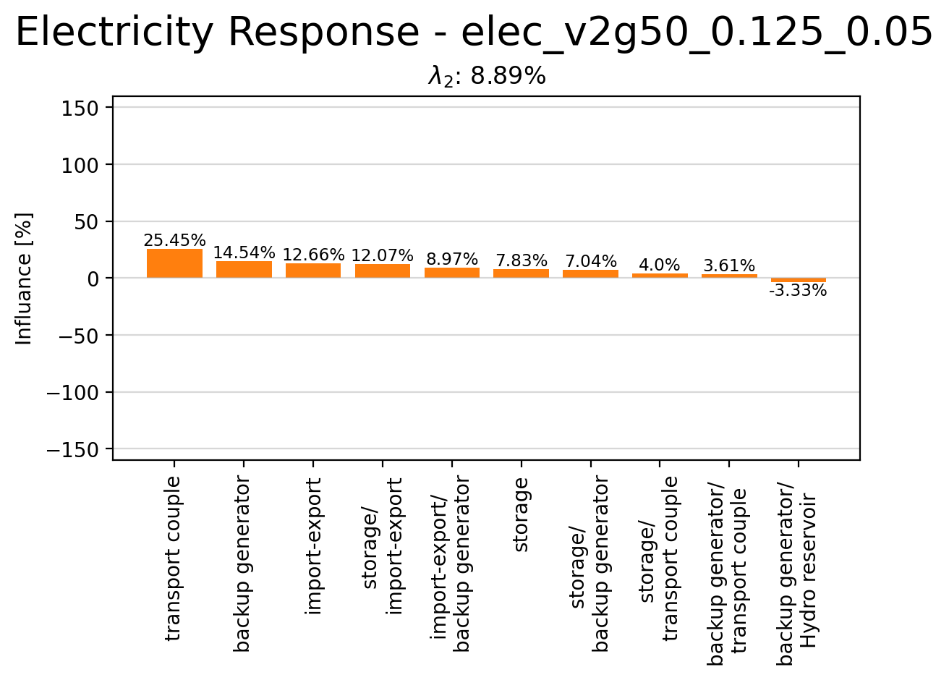
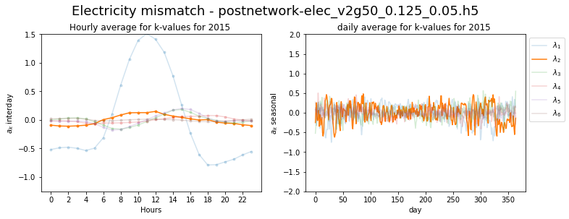
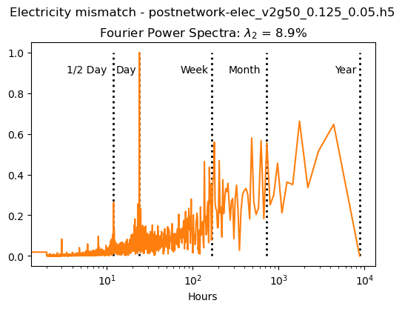
Principle Component 2

Slide 9
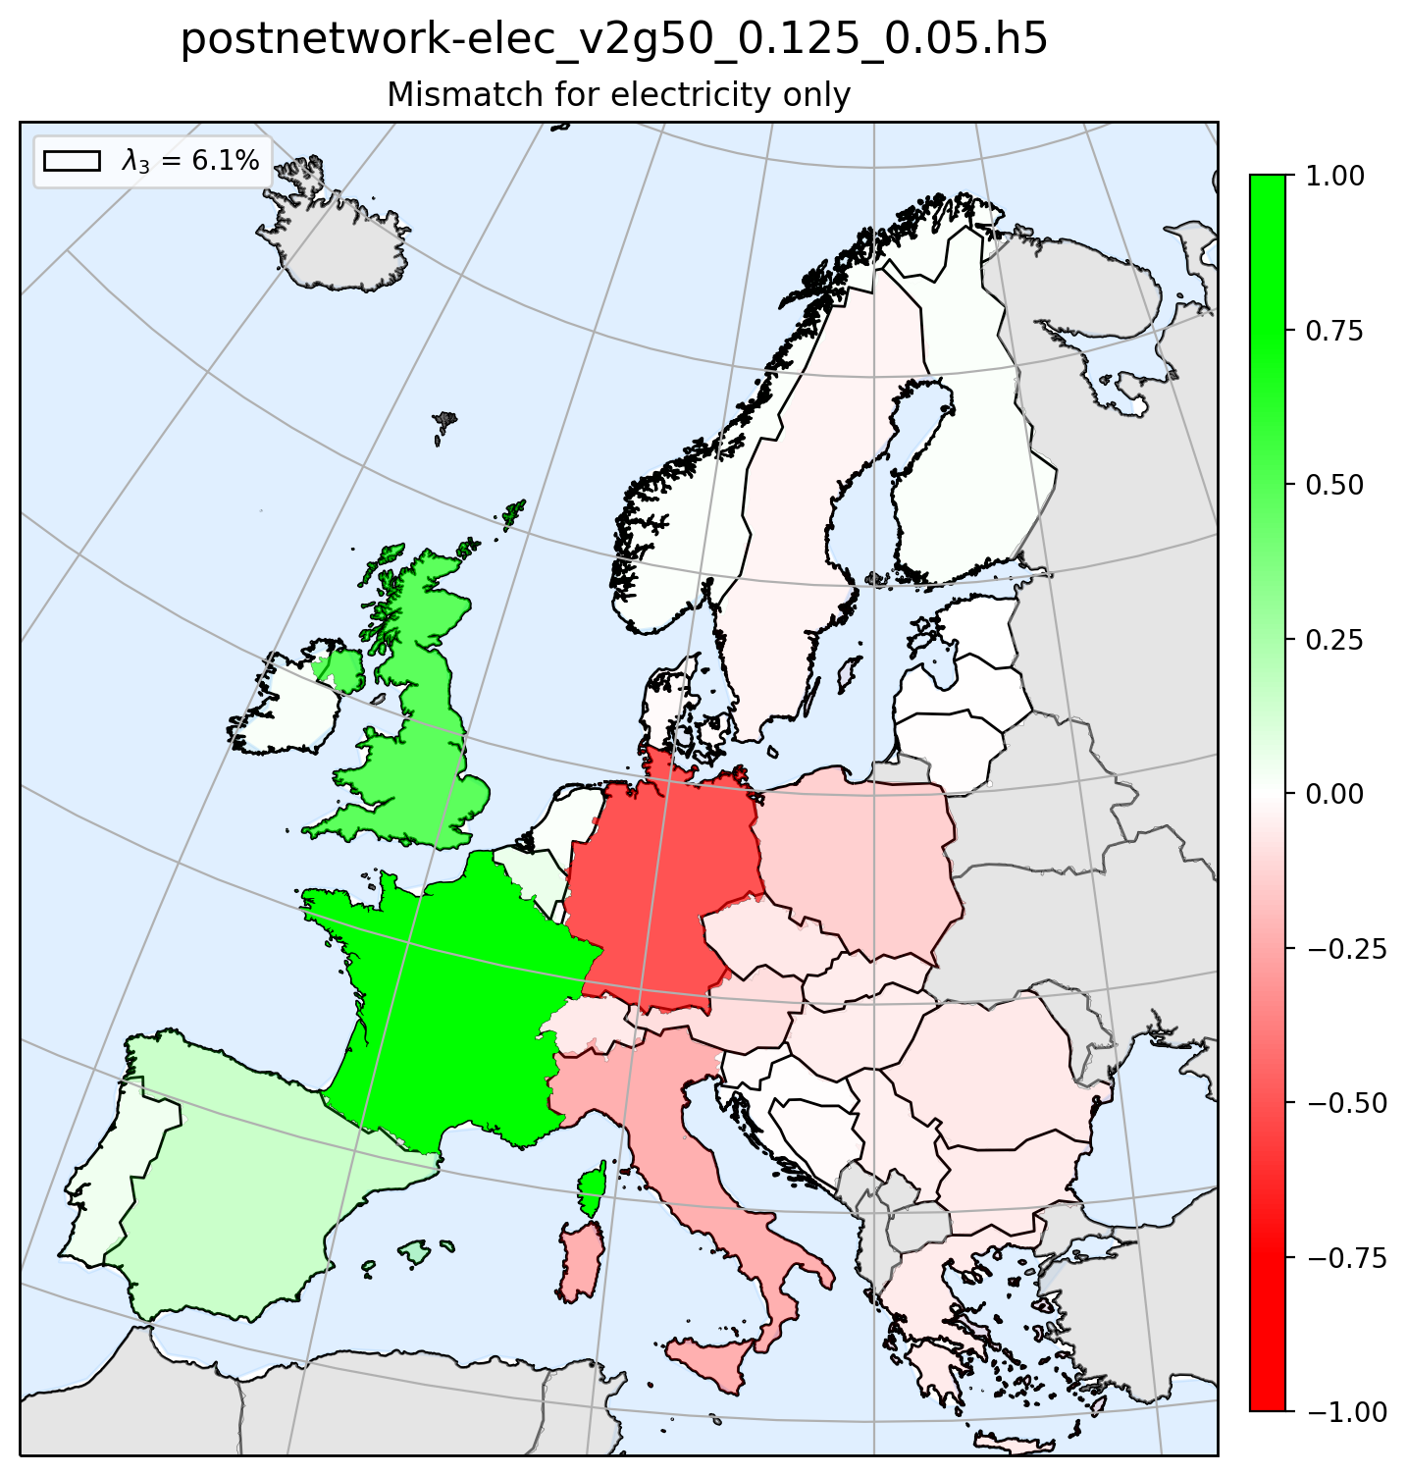
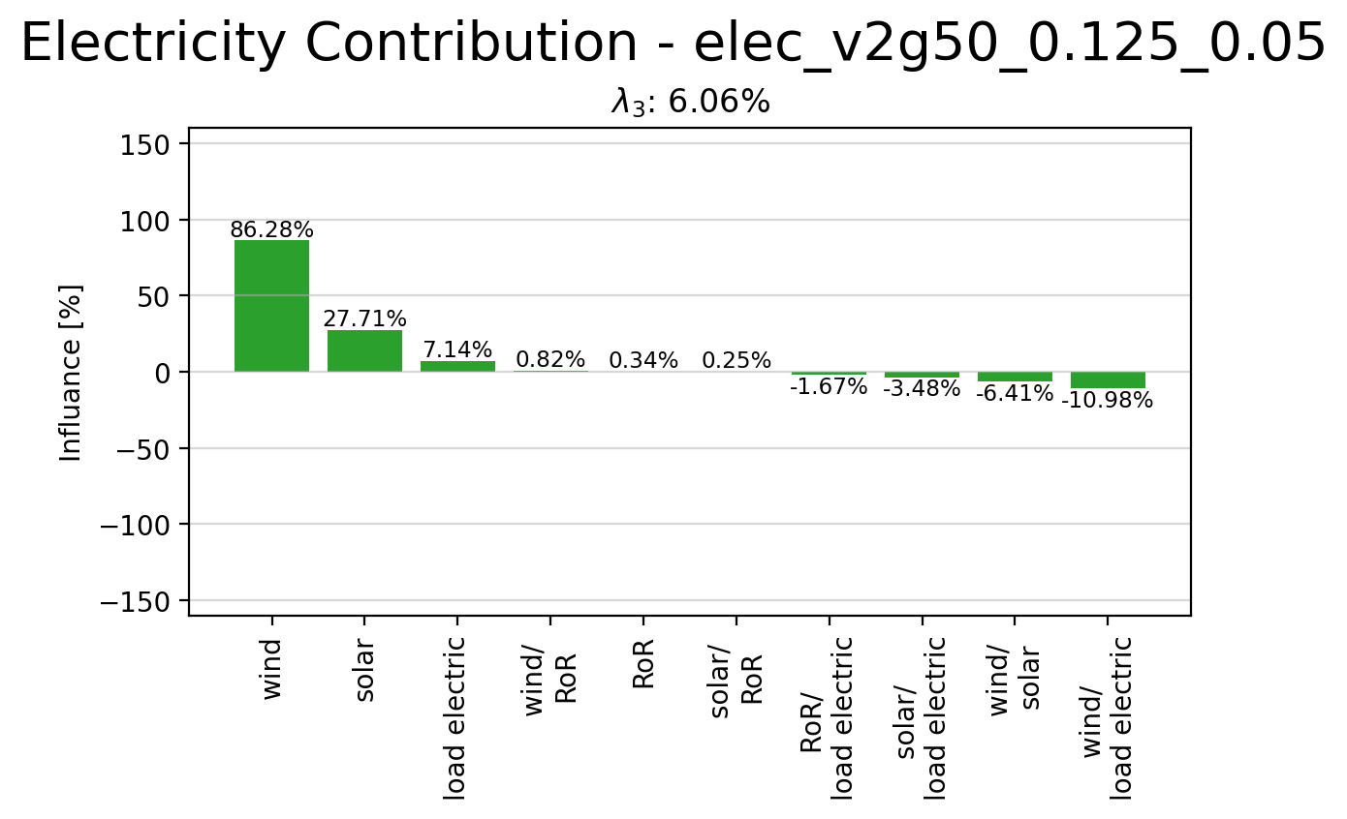
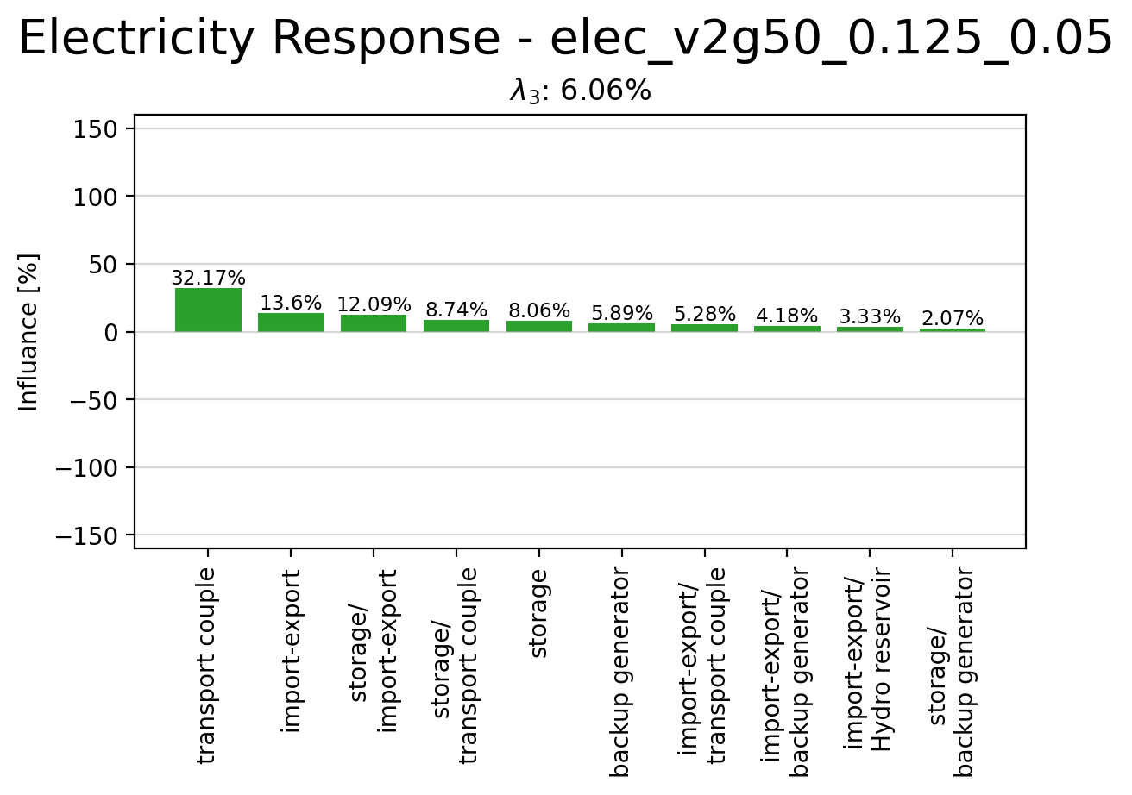
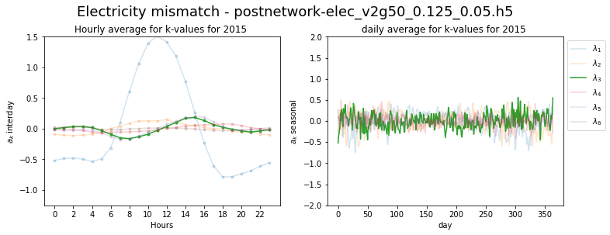
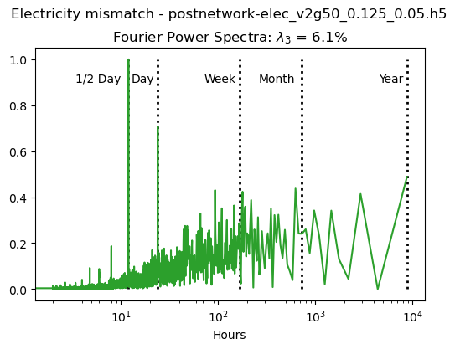
Principle Component 3

Slide 10
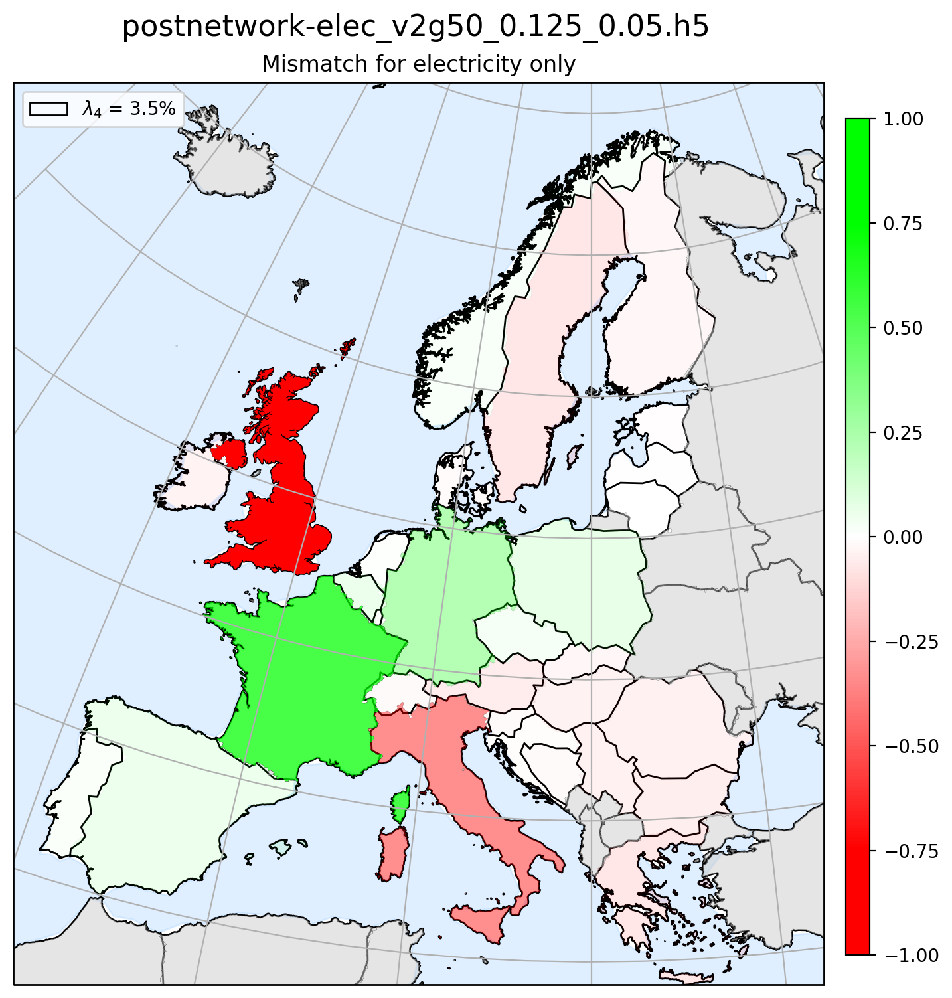
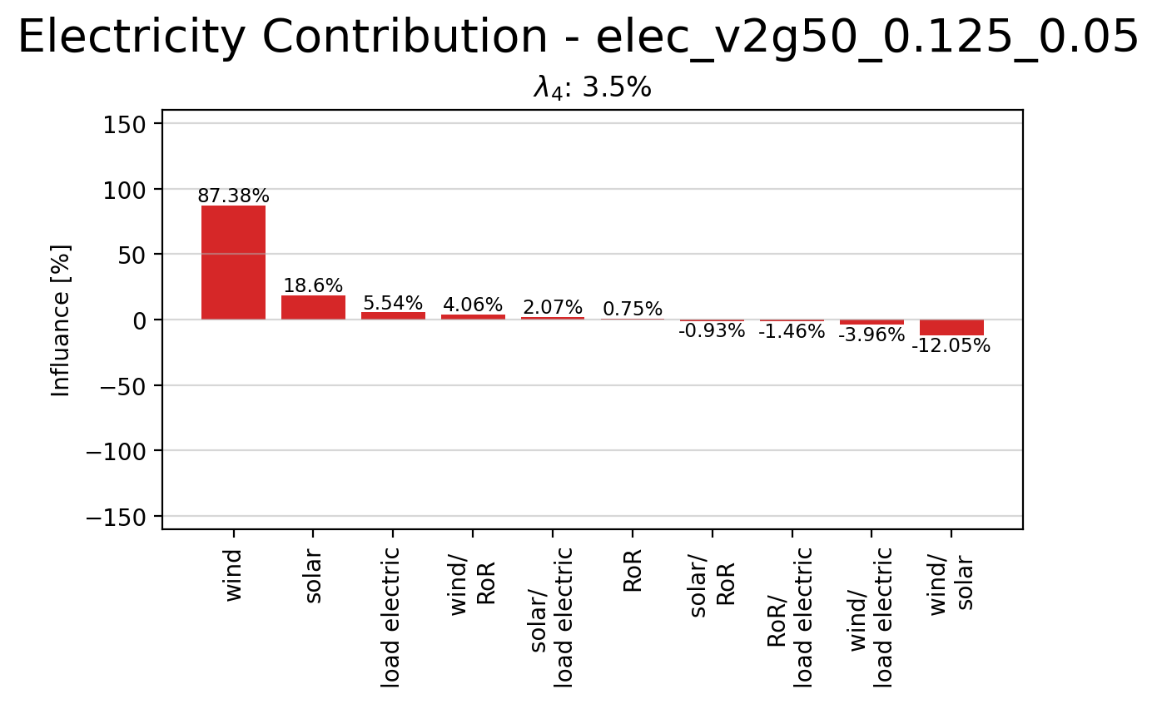
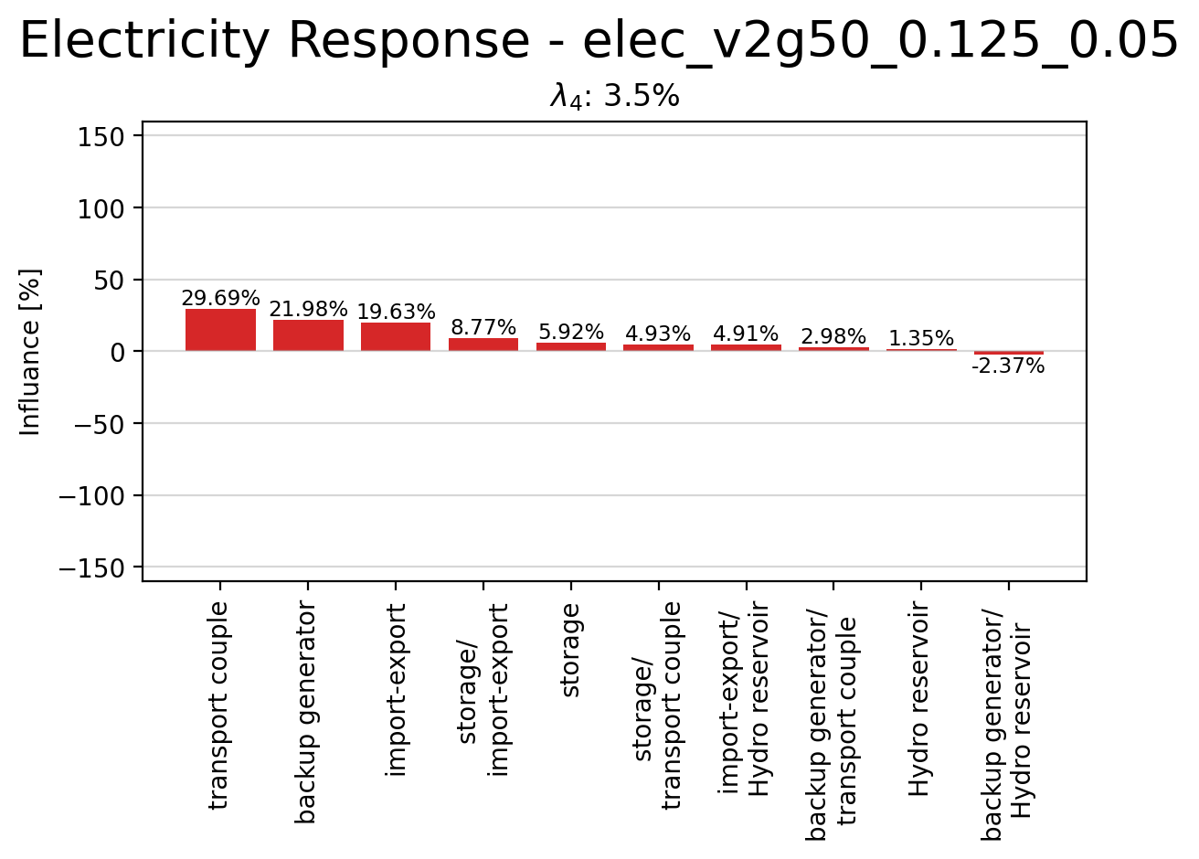
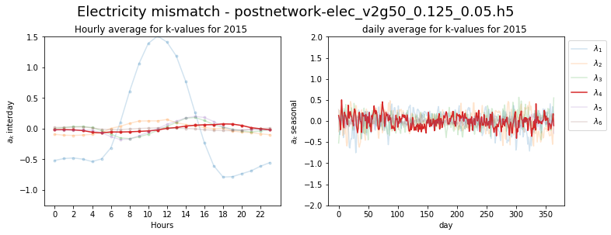
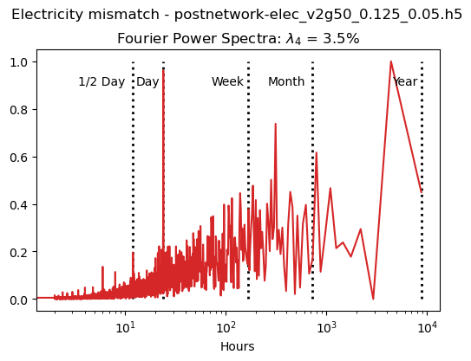
Principle Component 4

Slide 11
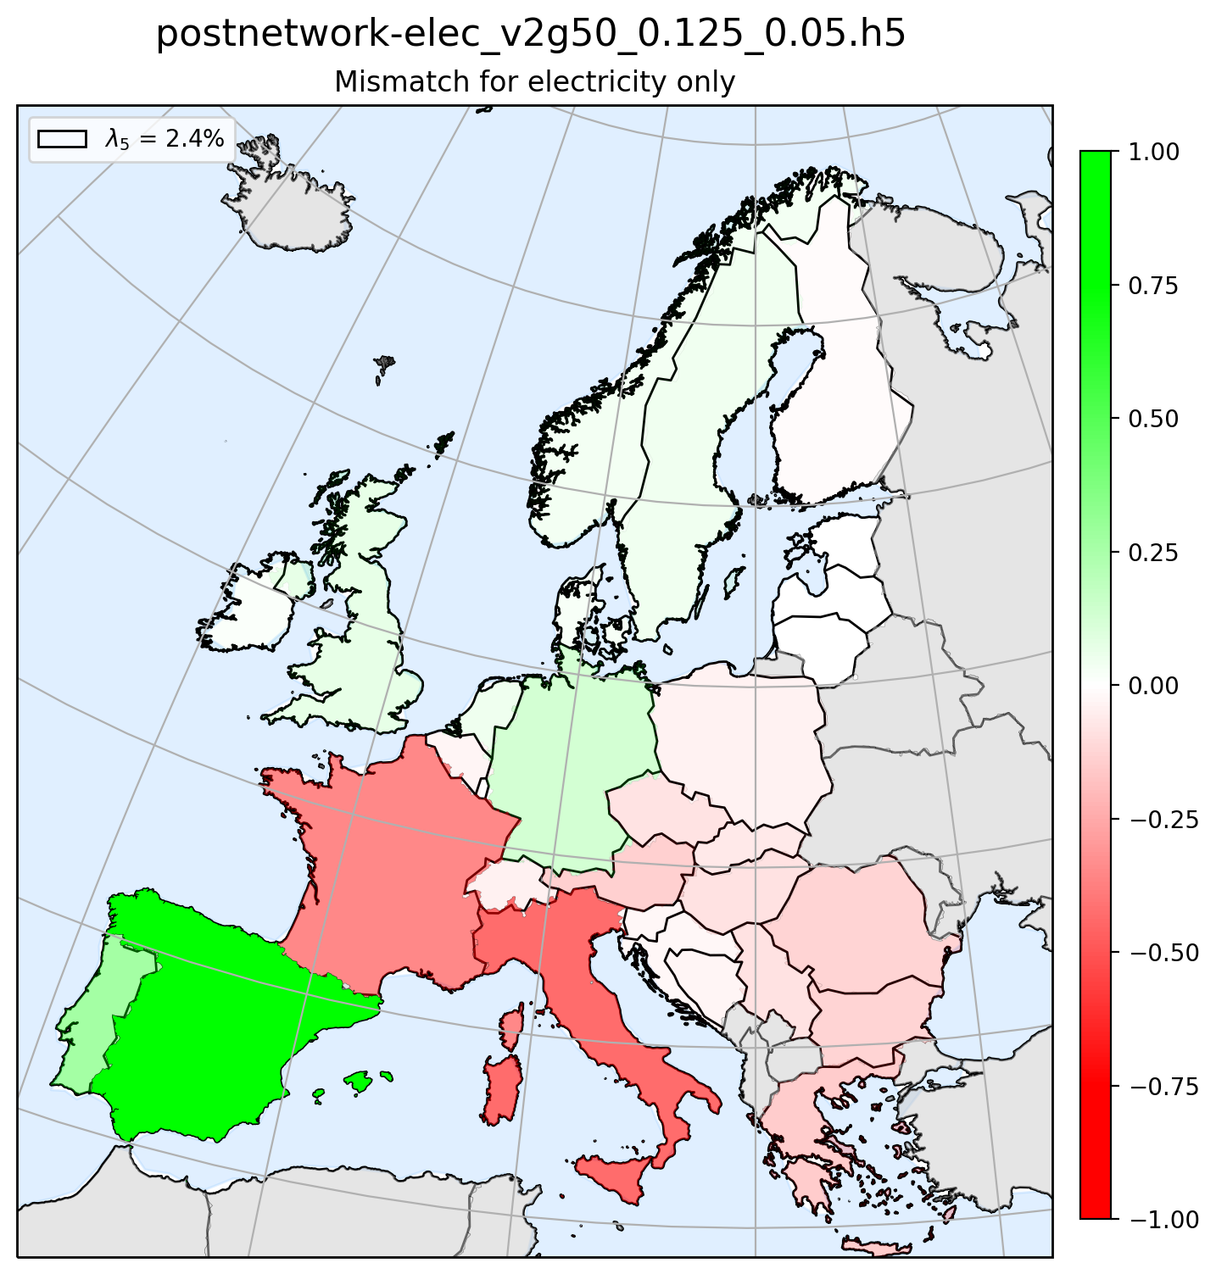
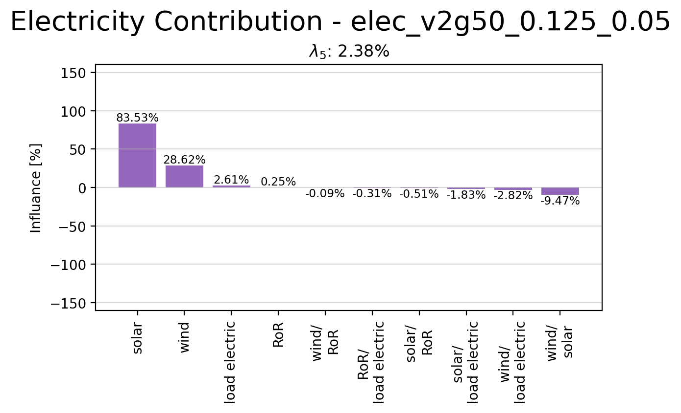
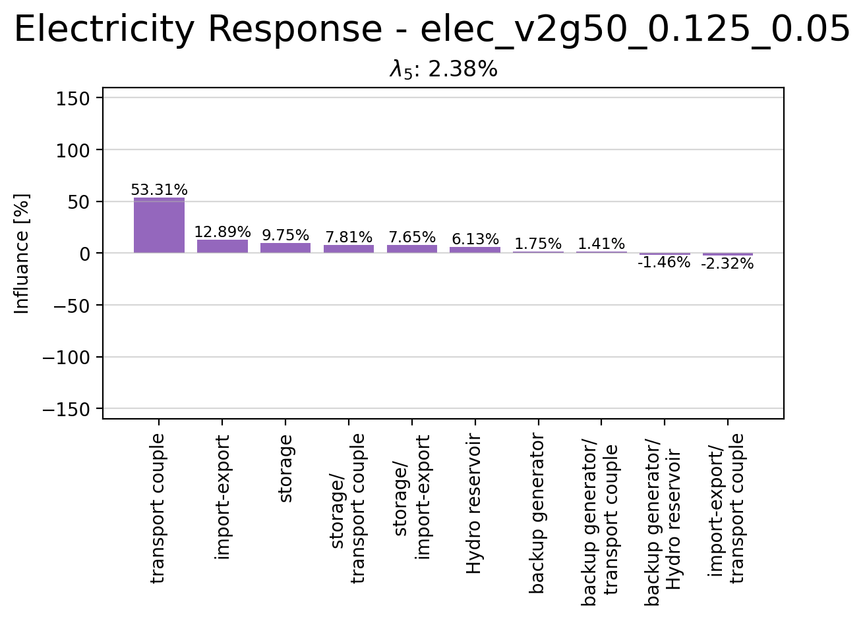
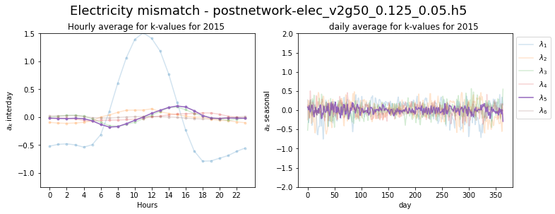
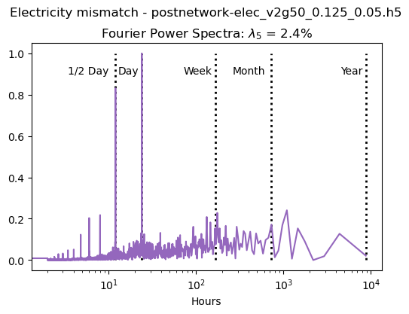
Principle Component 5

Slide 12
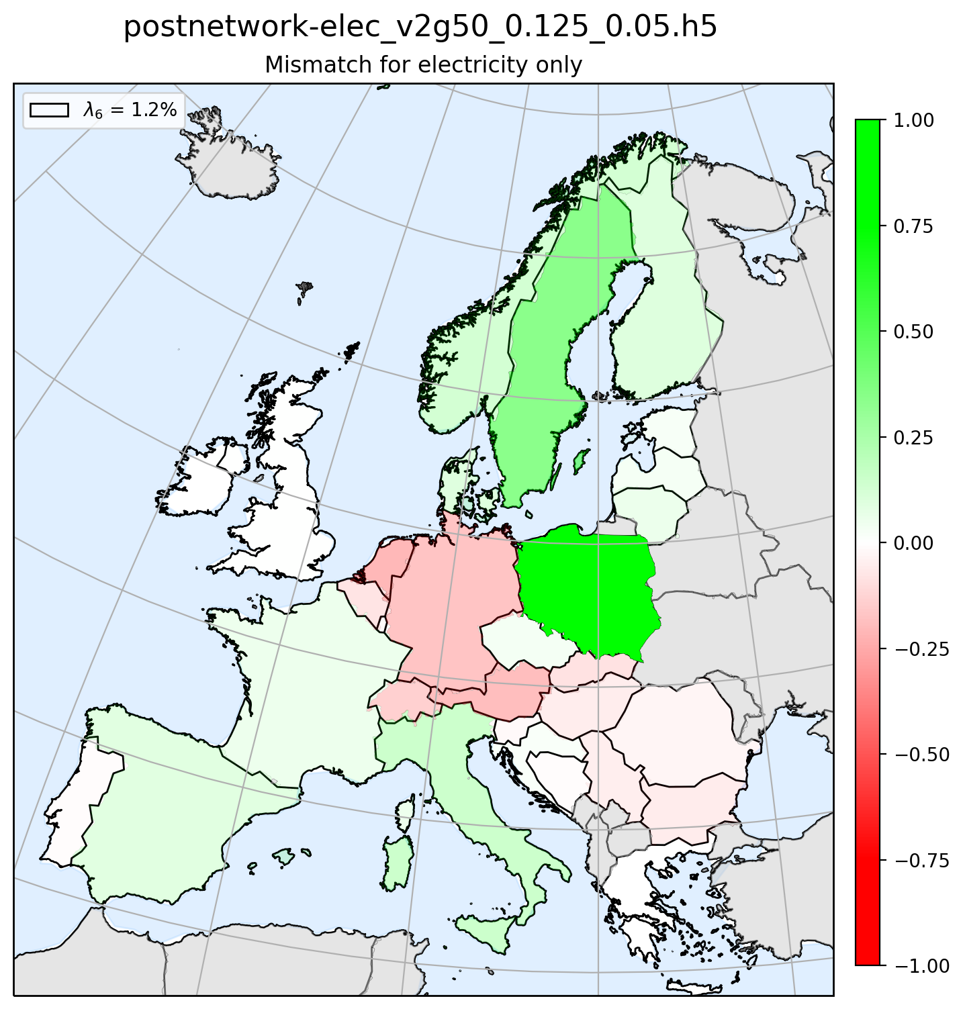
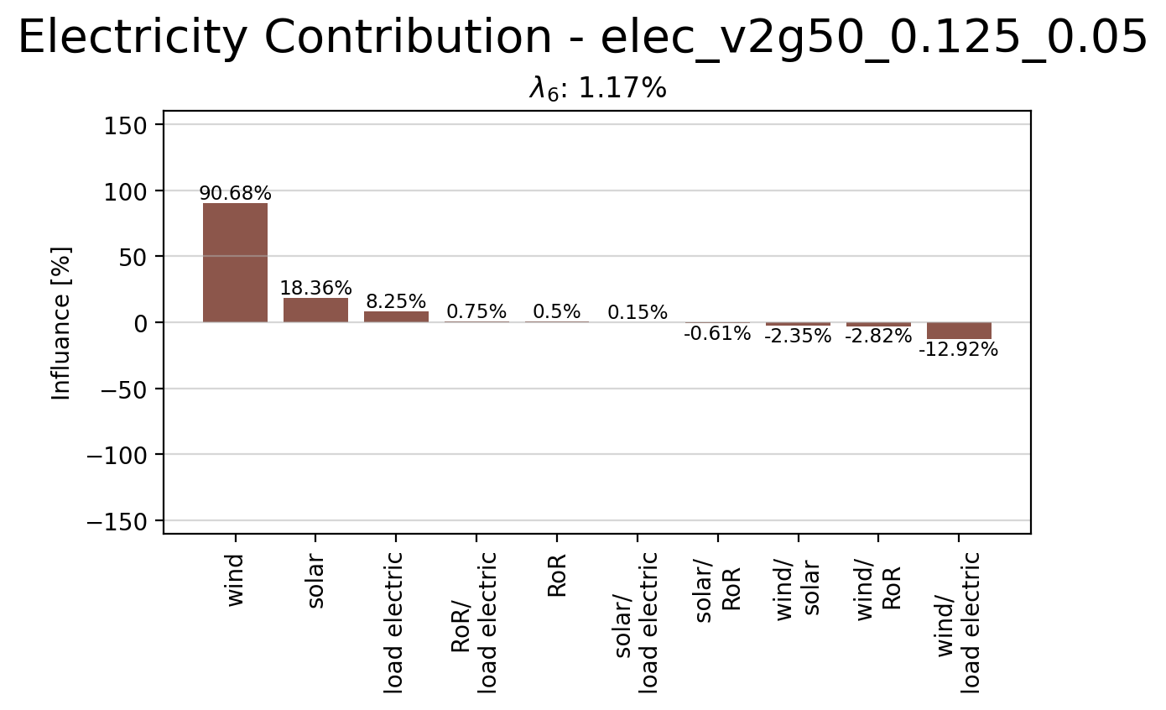
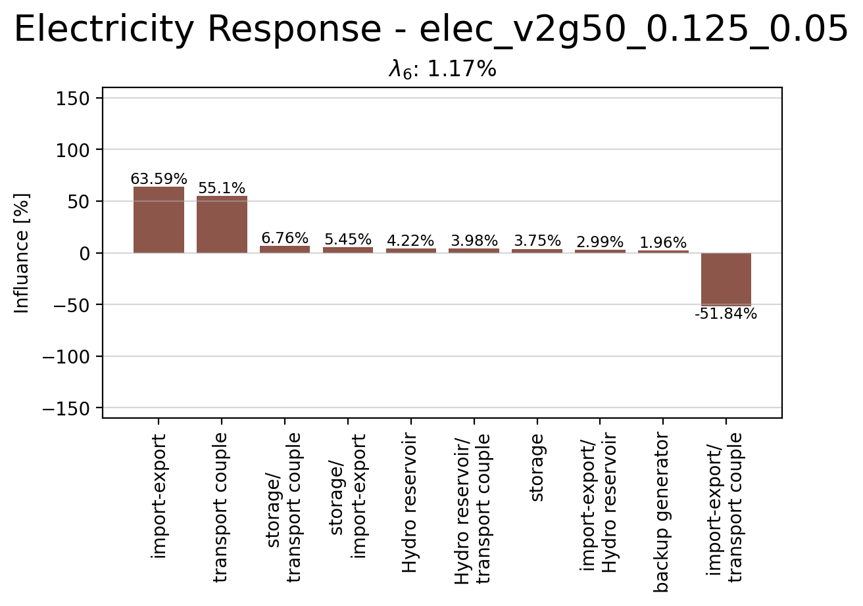
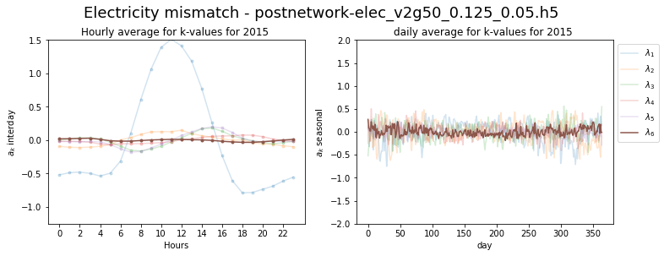
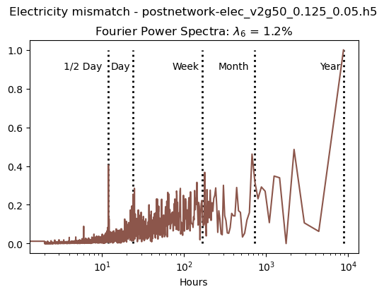
Principle Component 6

Slide 13
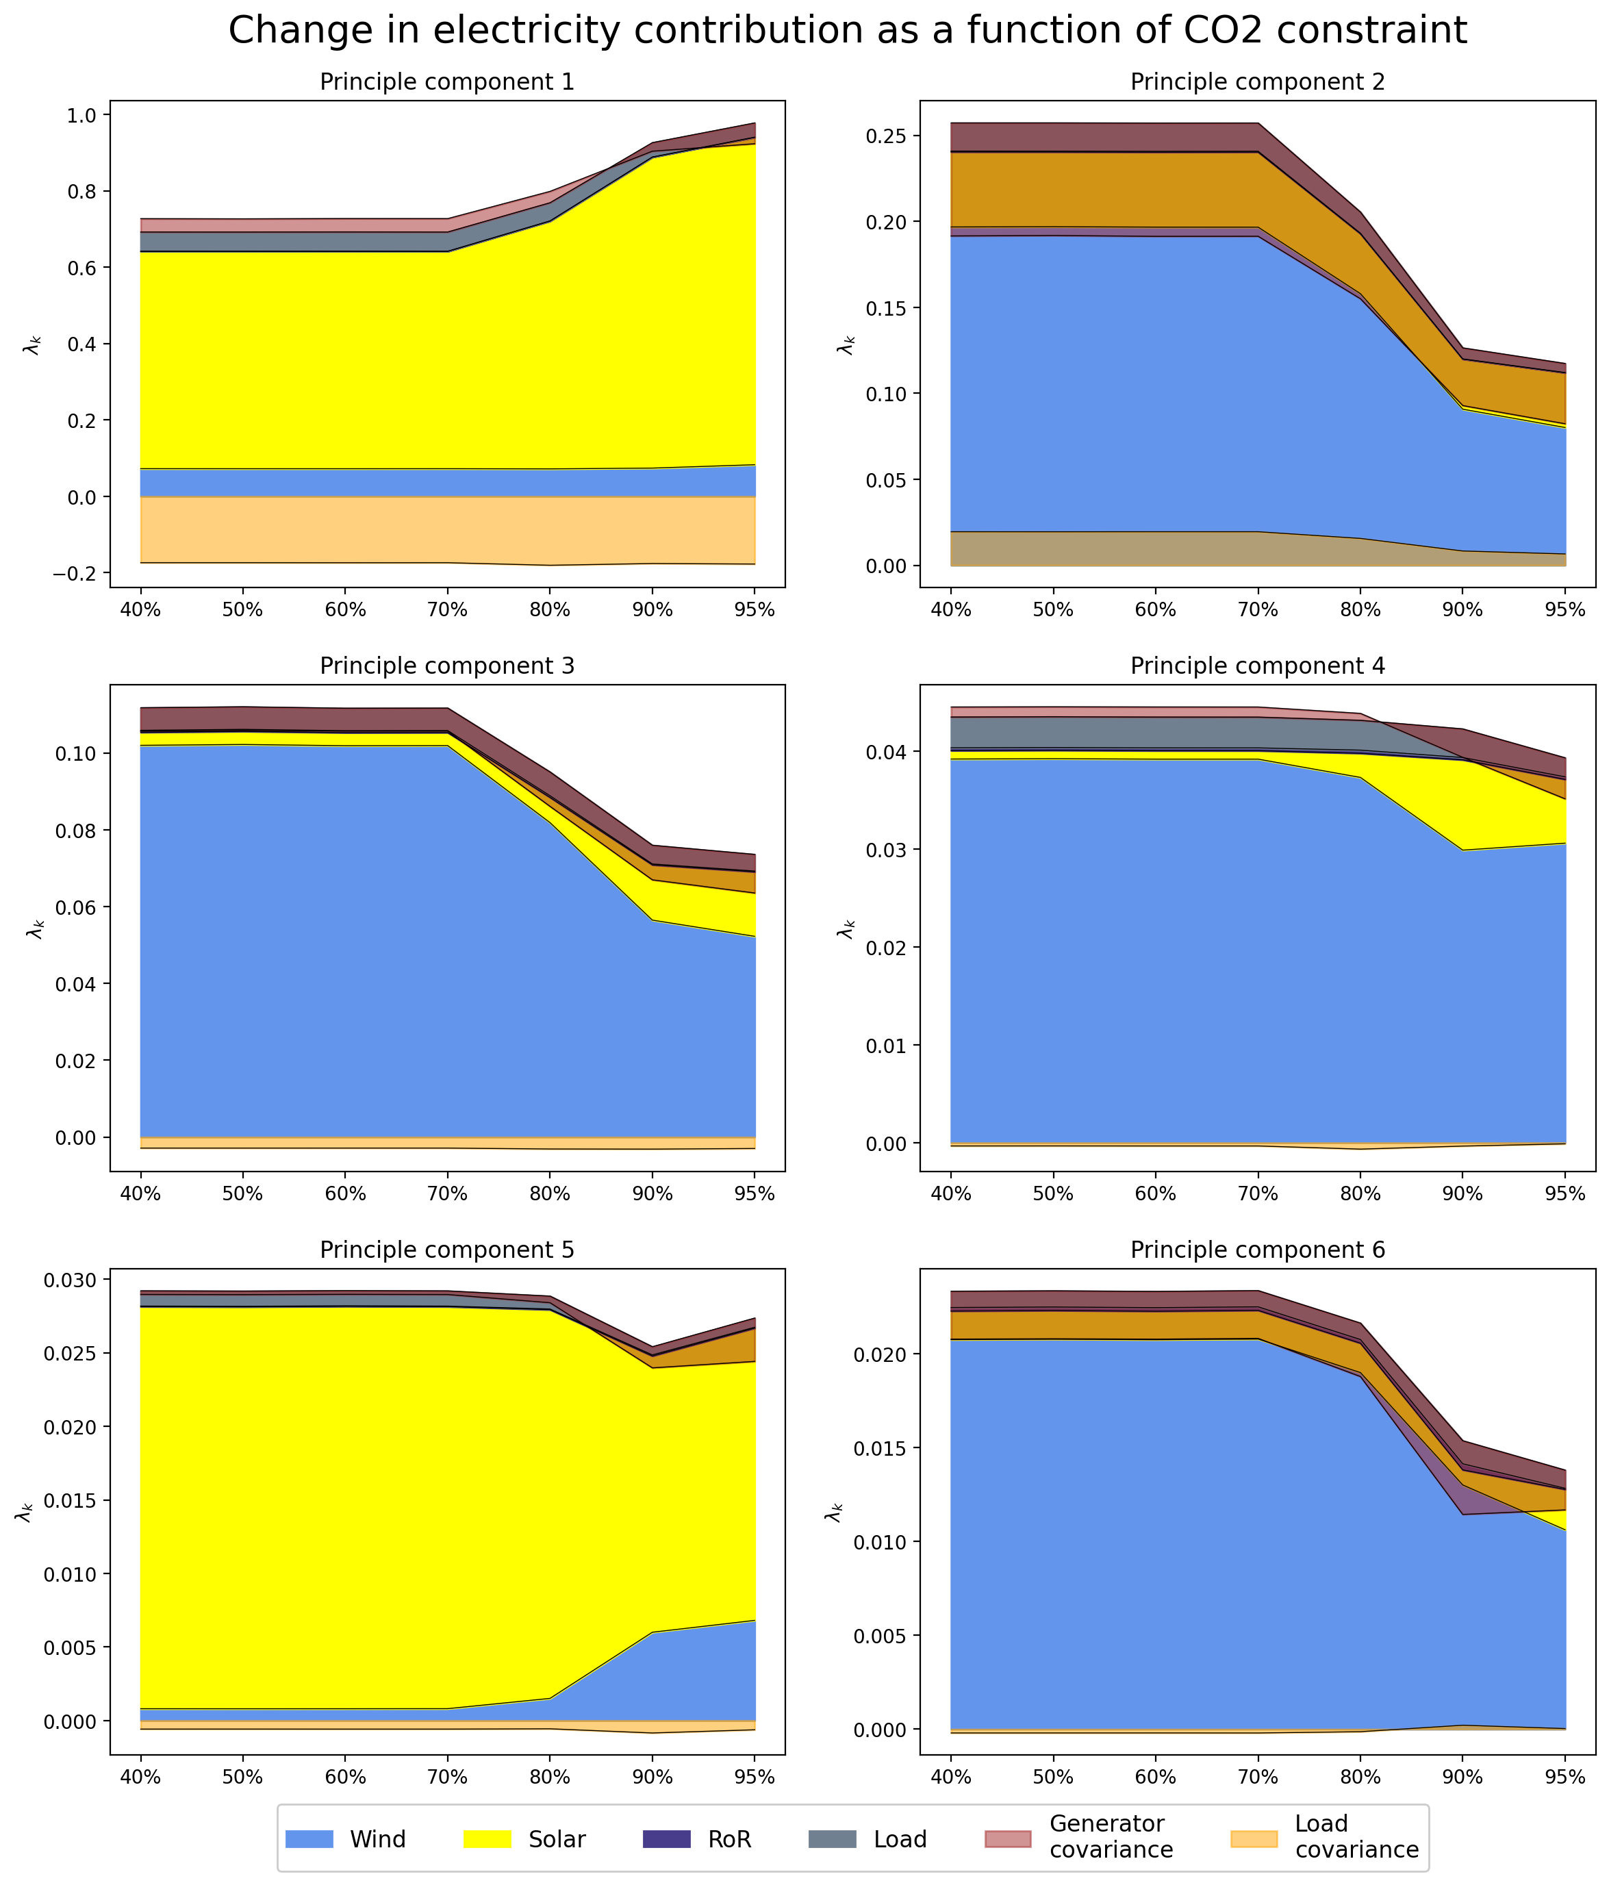
Change in Contribution due to CO2 Constrain

Slide 14
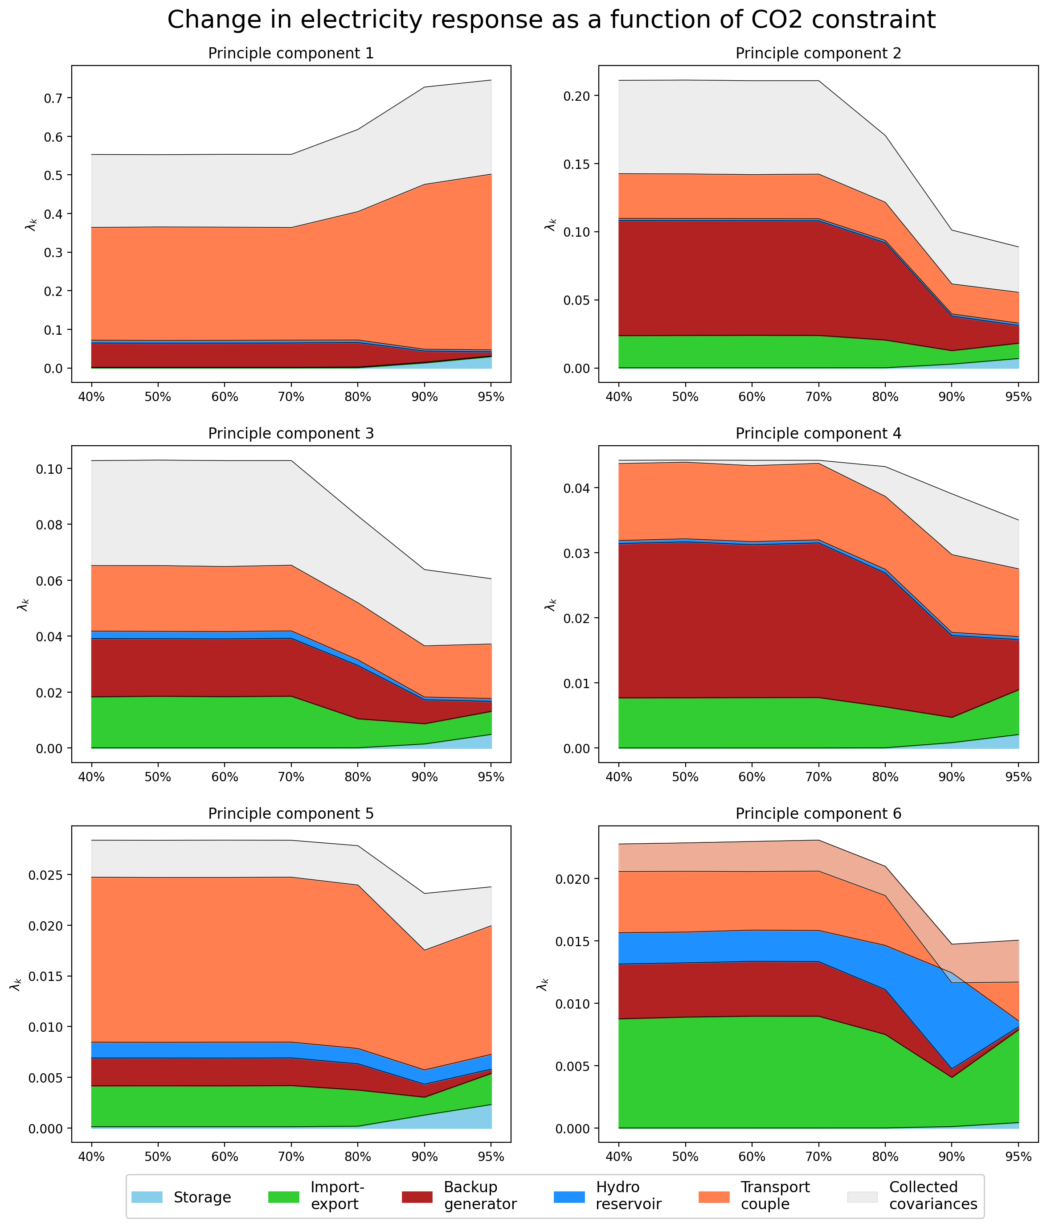
Change in Reponse due to CO2 Constrain

Slide 15
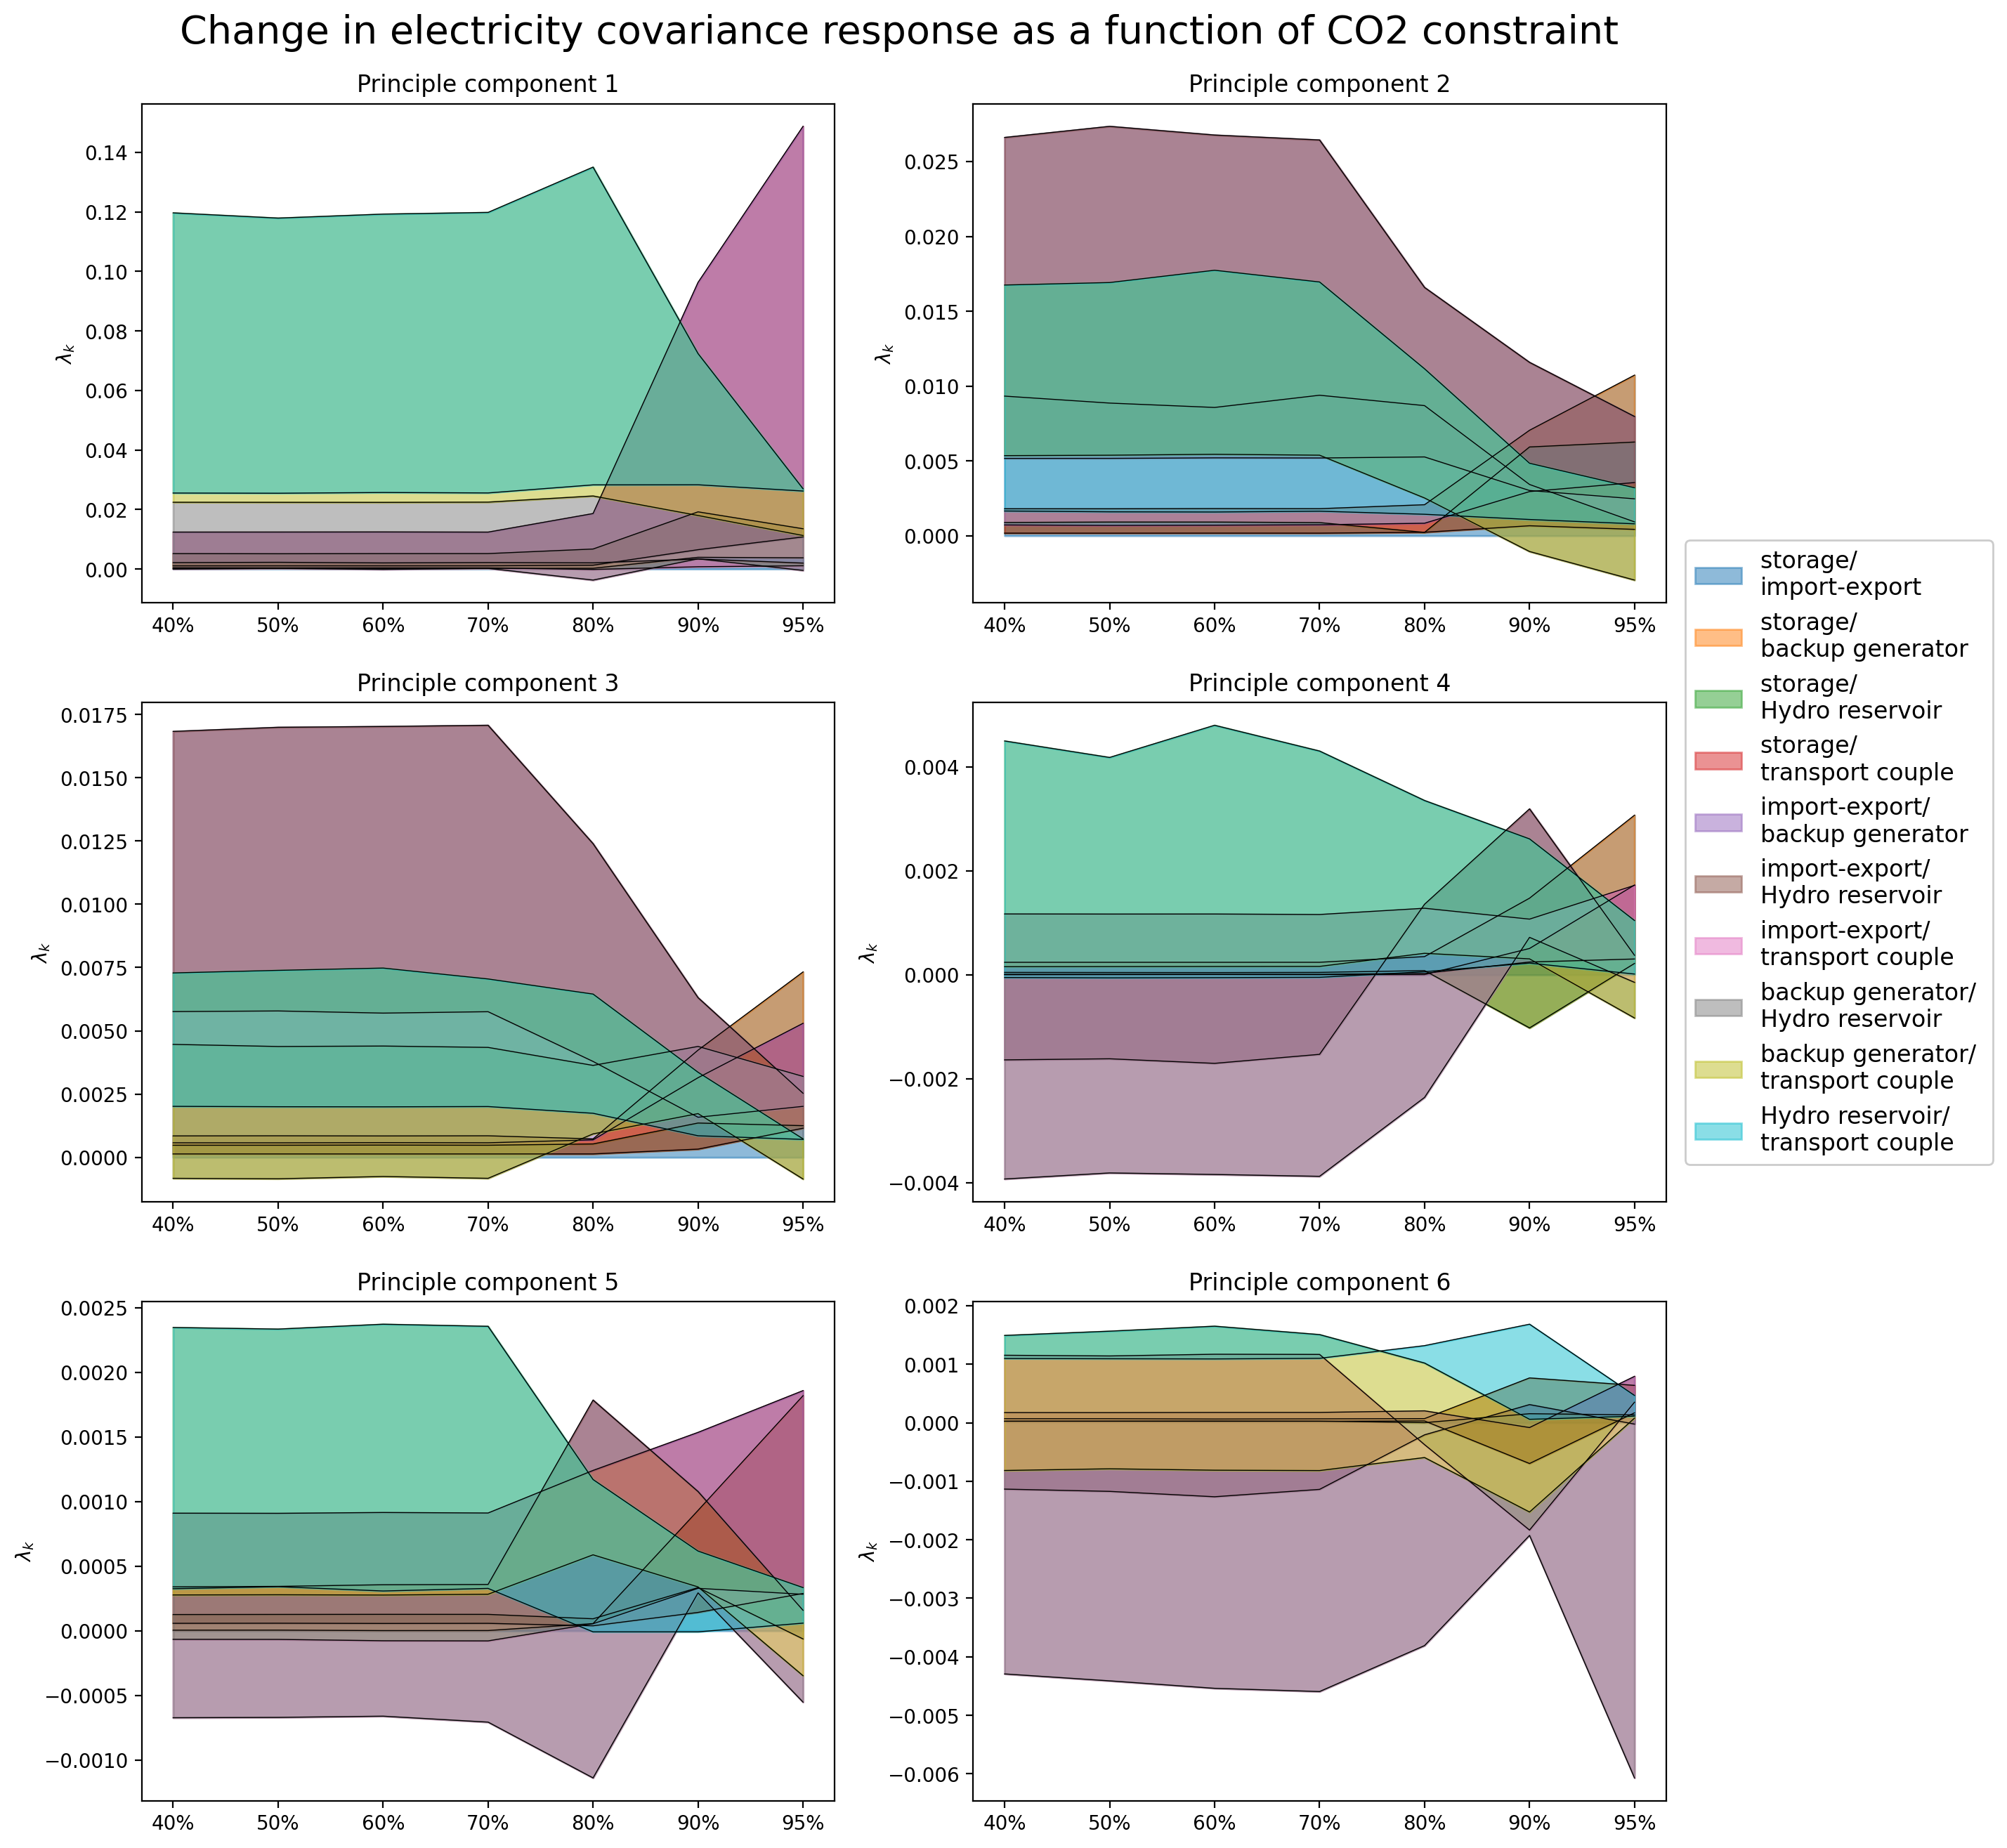
Change in Cov Reponse due to CO2 Constrain

Slide 16
Electricity Coupled with the Transport Sector
Electricity NP Analysis

Slide 17
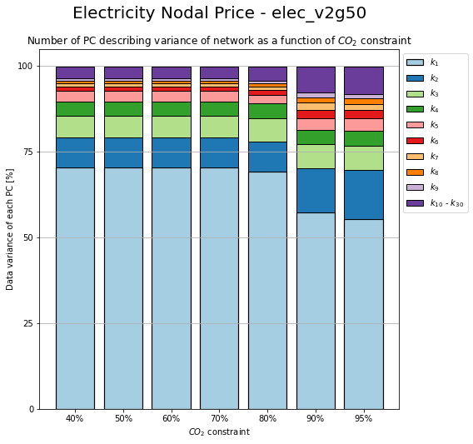
Change in PC due to CO2 Constrain

Slide 18
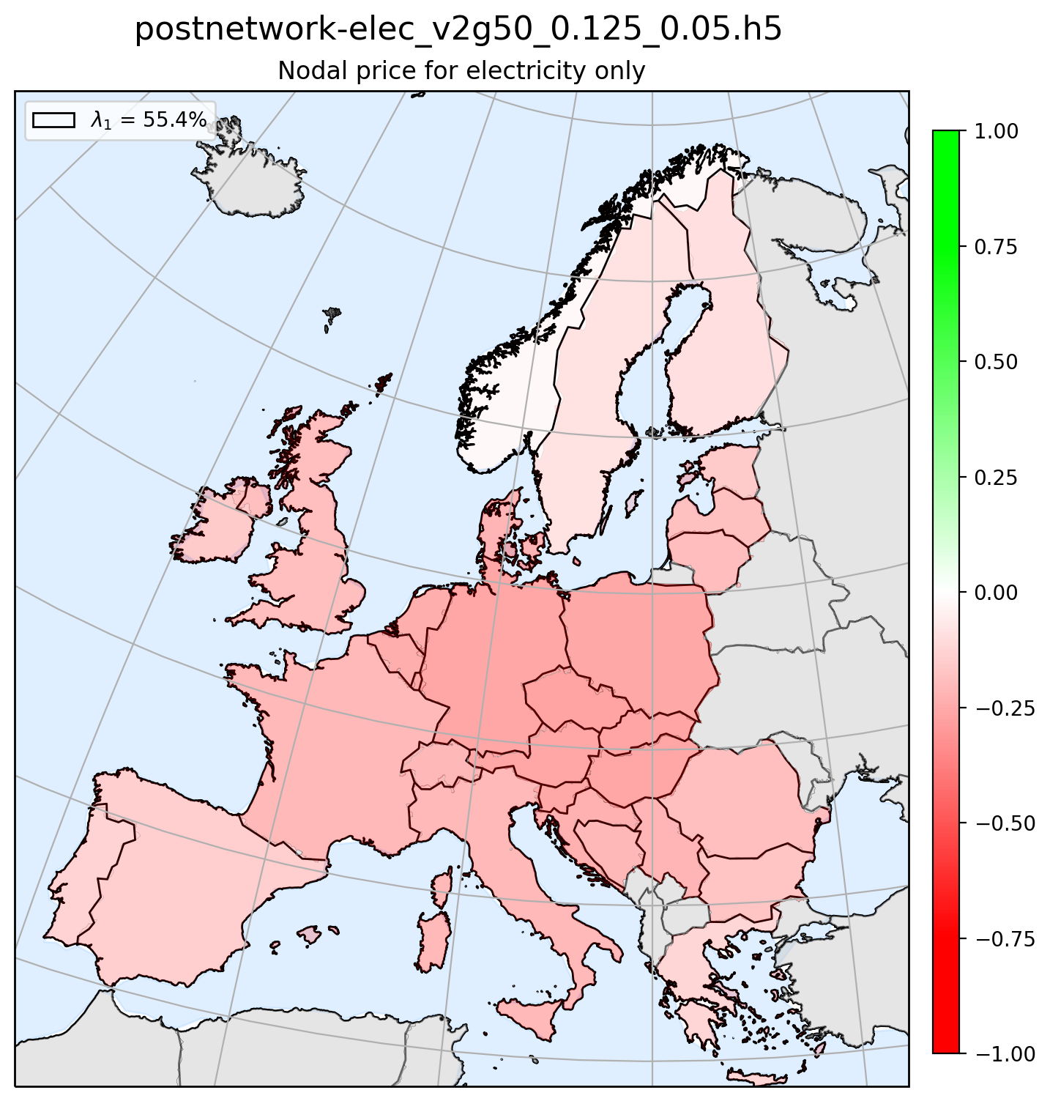
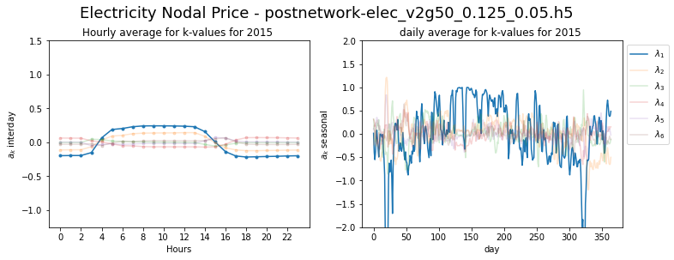
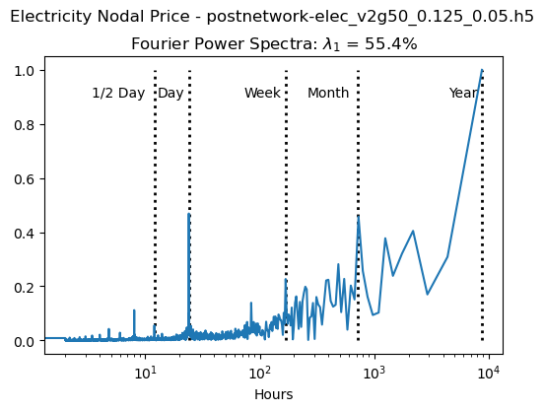
Principle Component 1

Slide 19
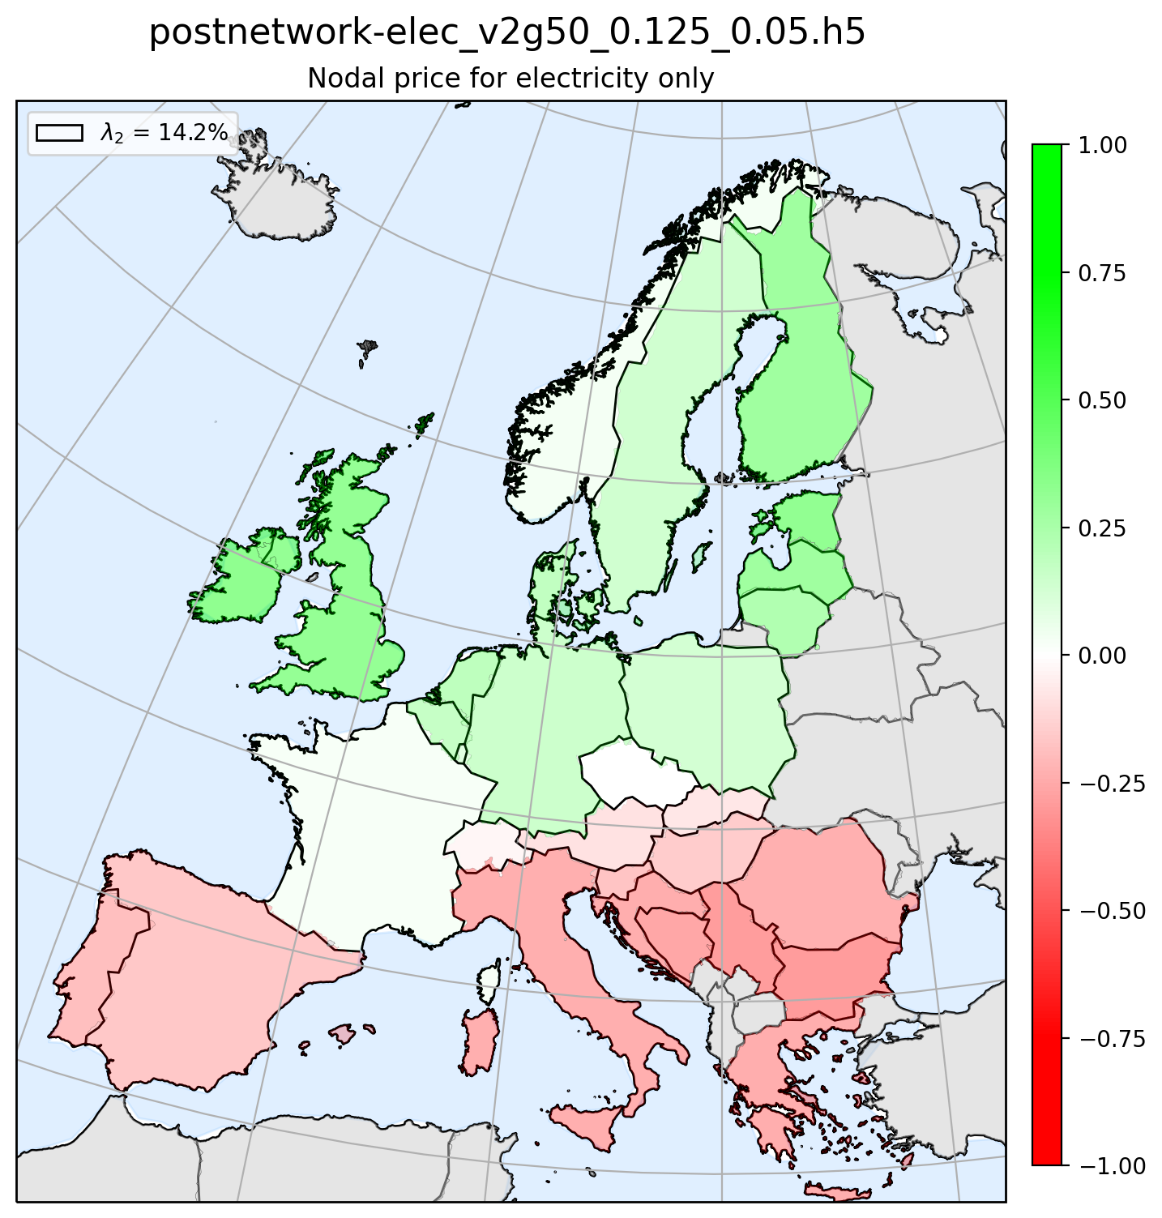
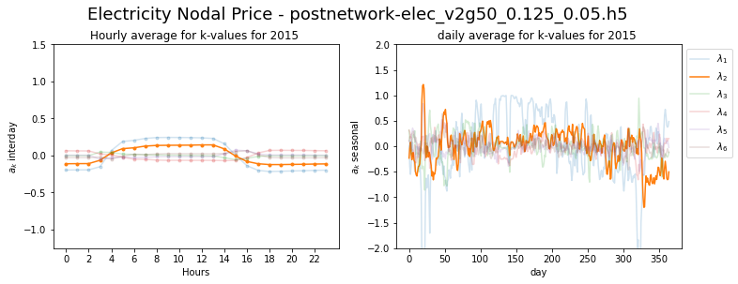
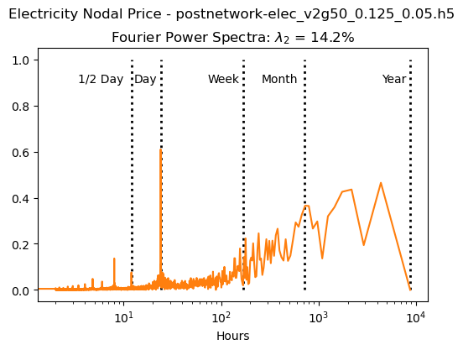
Principle Component 2

Slide 20
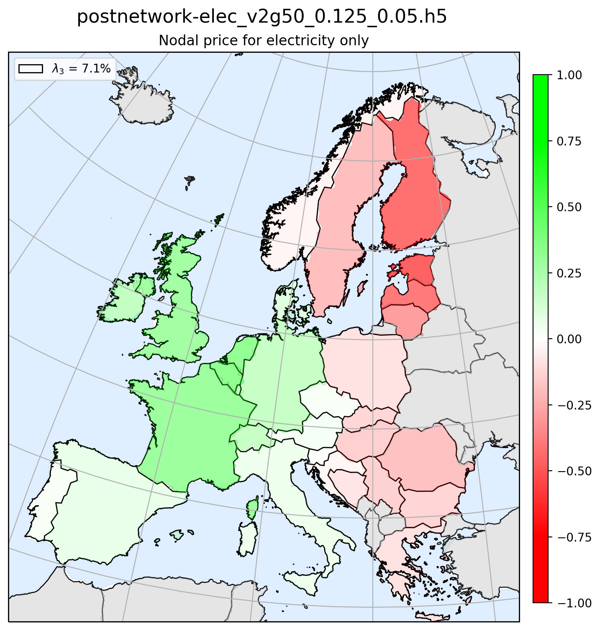
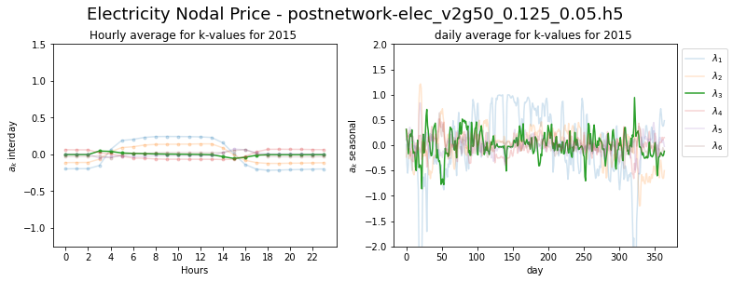
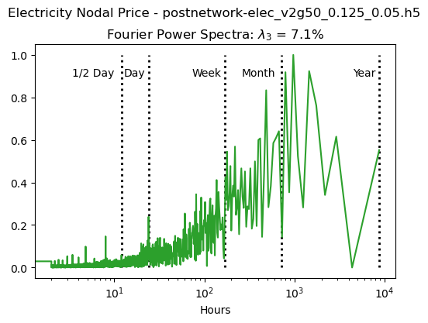
Principle Component 3

Slide 21
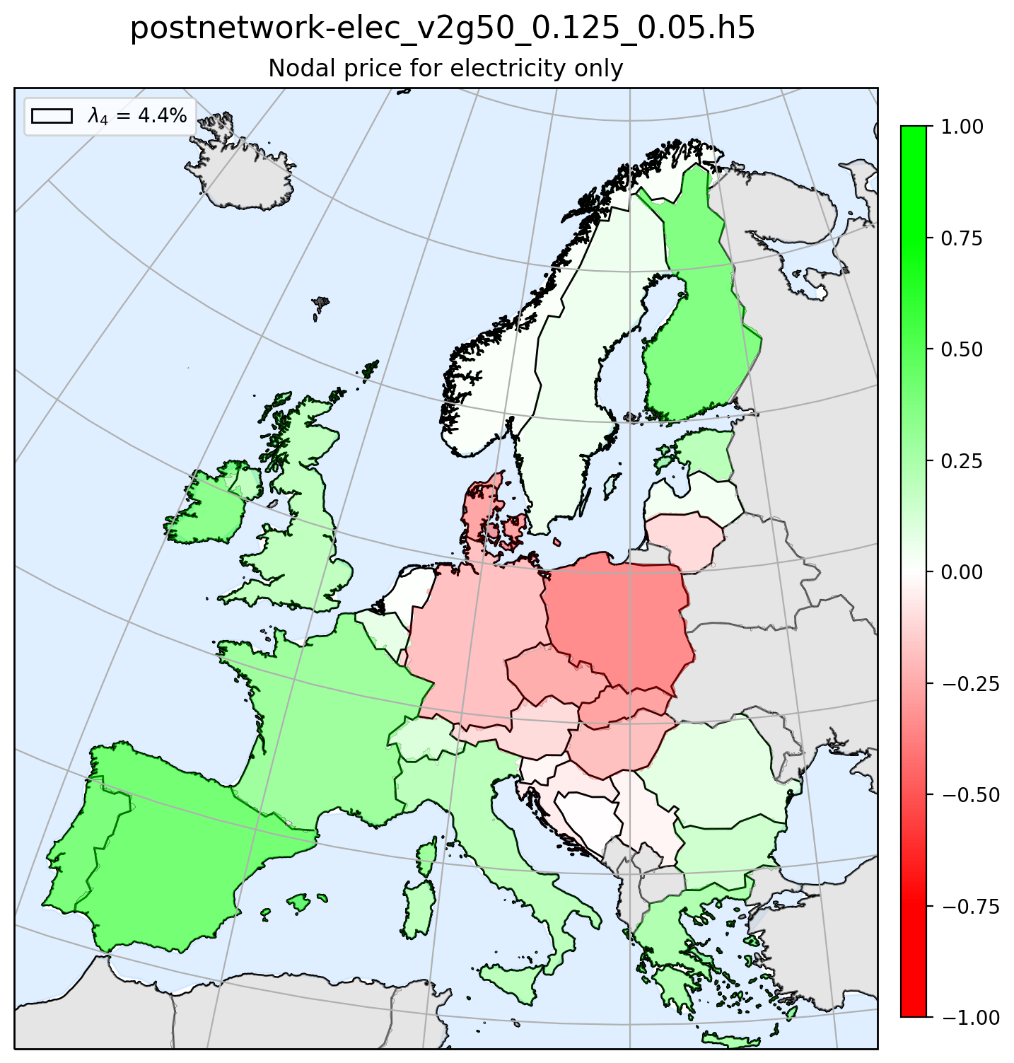
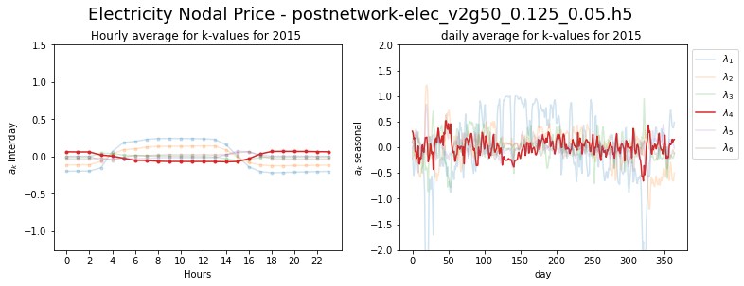

Principle Component 4

Slide 22



Principle Component 5

Slide 23



Principle Component 6

Slide 24
Electricity Coupled with the Transport Sector
Electricy Mismatch and NP Coherence

Slide 25

Coherence Method 1
Nodal Price
Mismatch
1)
2)
1)
2)
3)
4)
3)
4)
5)
6)
5)
6)

Slide 26

Coherence Method 2
Nodal Price
Mismatch
1)
2)
1)
2)
3)
4)
3)
4)
5)
6)
5)
6)

Slide 27

Coherence Method 3
Nodal Price
Mismatch
1)
2)
1)
2)
3)
4)
3)
4)
5)
6)
5)
6)

Slide 28
Electricity Coupled with the Transport Sector
Transport Mismatch Analysis

Slide 29

Installed storage (energy capacity)

Slide 30

Installed storage (power capacity)

Slide 31

Change in PC due to CO2 Constrain

Slide 32



Principle Component 1

Slide 33



Principle Component 2

Slide 34



Principle Component 3

Slide 35



Principle Component 4

Slide 36



Principle Component 5

Slide 37



Principle Component 6

Slide 38
Electricity Coupled with the Transport Sector
Transport NP Analysis

Slide 39

Change in PC due to CO2 Constrain

Slide 40



Principle Component 1

Slide 41



Principle Component 2

Slide 42



Principle Component 3

Slide 43



Principle Component 4

Slide 44



Principle Component 5

Slide 45



Principle Component 6

Slide 46
Electricity Coupled with the Transport Sector
Transport Mismatch and NP Coherence

Slide 47

Coherence Method 1
Nodal Price
Mismatch
1)
2)
1)
2)
3)
4)
3)
4)
5)
6)
5)
6)

Slide 48

Coherence Method 2
Nodal Price
Mismatch
1)
2)
1)
2)
3)
4)
3)
4)
5)
6)
5)
6)

Slide 49

Coherence Method 3
Nodal Price
Mismatch
1)
2)
1)
2)
3)
4)
3)
4)
5)
6)
5)
6)

Slide 50
Electricity Coupled with the Transport Sector
Electricity NP and Transport NP Coherence

Slide 51

Coherence Method 1
TNP
ENP
1)
2)
1)
2)
3)
4)
3)
4)
5)
6)
5)
6)

Slide 52

Coherence Method 2
TNP
ENP
1)
2)
1)
2)
3)
4)
3)
4)
5)
6)
5)
6)

Slide 53

Coherence Method 3
TNP
ENP
1)
2)
1)
2)
3)
4)
3)
4)
5)
6)
5)
6)

